Slide 1
SFRA Funding
Weighted student formula, provides funding based on district characteristics – enrollment and student characteristics
Provides additional funds (“weights”) for at risk, English language learners, special education students
District’s characteristics determine the “adequacy budget” based on base costs and weighted enrollment

Slide 2
Adequacy Budget
The adequacy budget is funded through two sources:
Local Revenue – formula determines each district’s ability to pay based on property wealth and income
State Revenue – state revenue makes up the rest

Slide 3
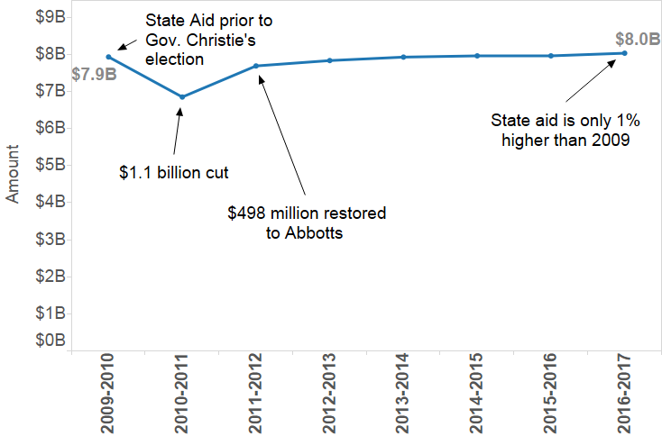
A Timeline of State Aid under Governor Christie

Slide 4
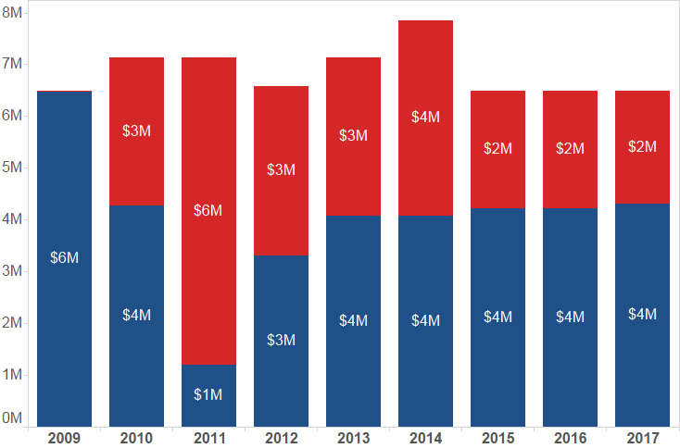
South Orange- Maplewood: Underfunding of State Aid
Proposed

Slide 5
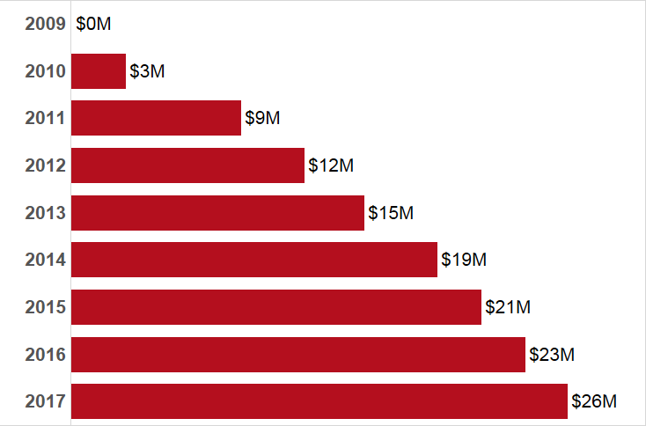
South Orange- Maplewood: Cumulative Underfunding
Proposed
Proposed

Slide 6
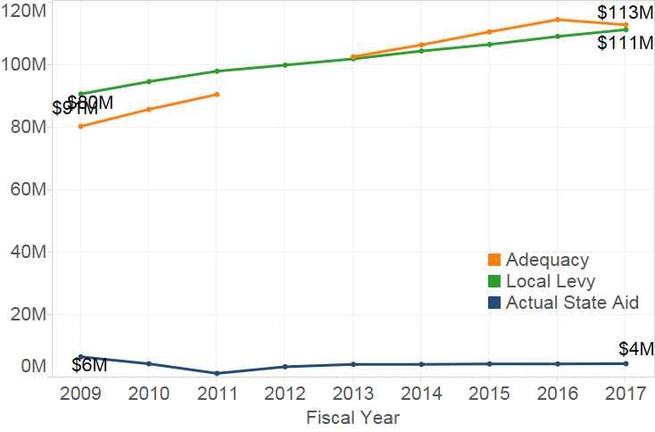
South Orange- Maplewood : Change in adequacy, local and state revenue

Slide 7
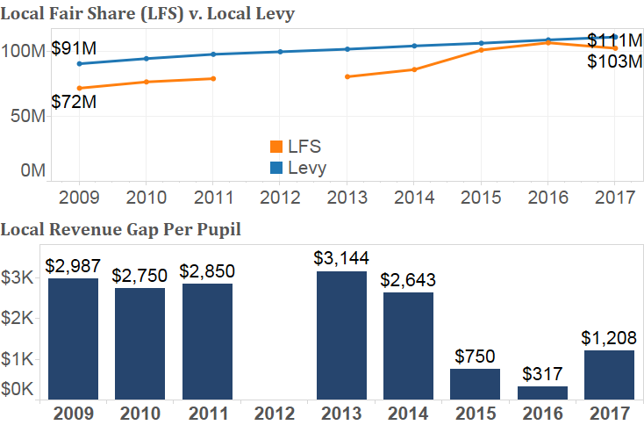
South Orange- Maplewood : Local funding

Slide 8
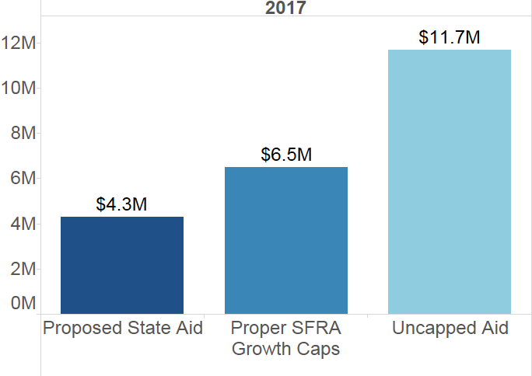
South Orange- Maplewood: State Aid

Slide 9
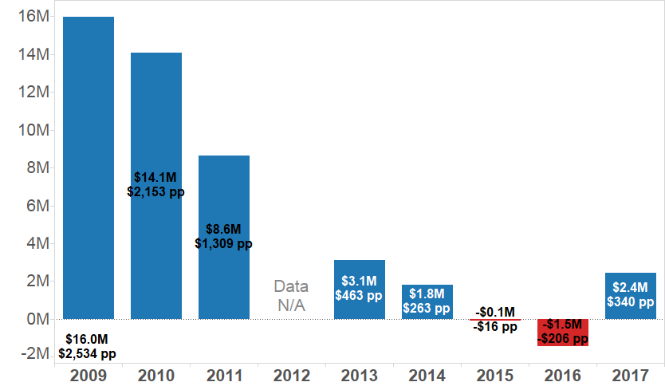
South Orange- Maplewood : Funding relative to adequacy

Slide 10
Impact of underfunding on schools
What happens when state aid is flat?
Broken formula does not respond to:
Enrollment changes
Changing student composition, i.e. more at risk and ELL students
Increasing costs – salaries, benefits, supplies, etc.

Slide 11
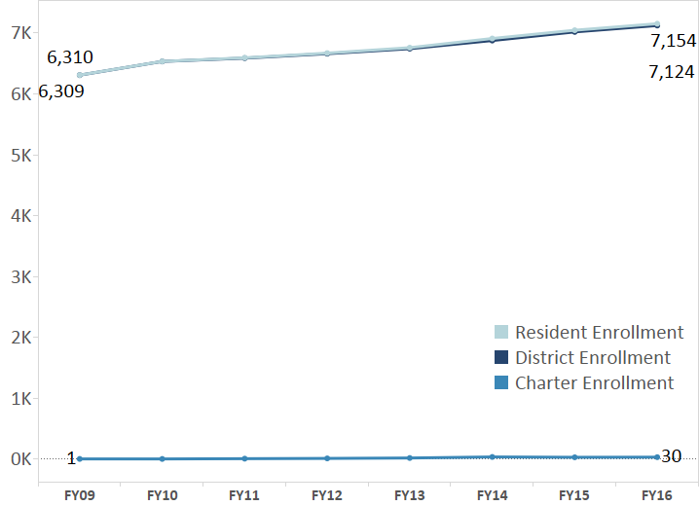
District Enrollments

Slide 12
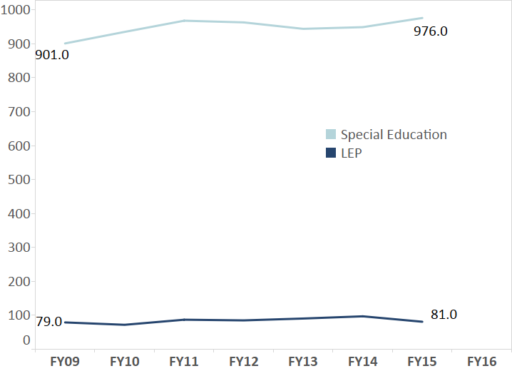
Enrollments for Special Education and English language learners

Slide 13
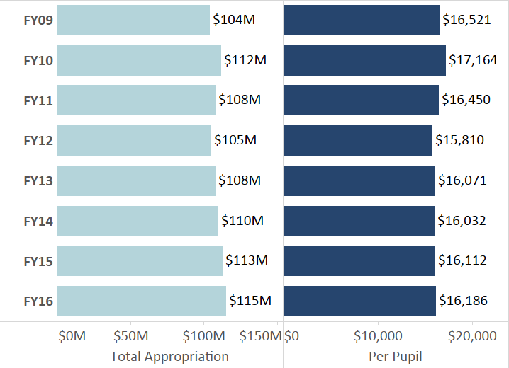
Total Expenditures

Slide 14
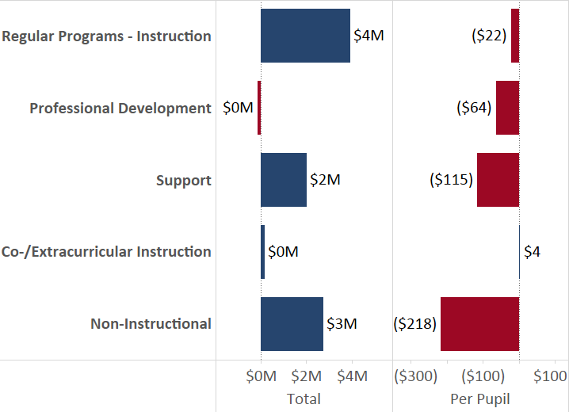
Change in expenditures by category

Slide 15
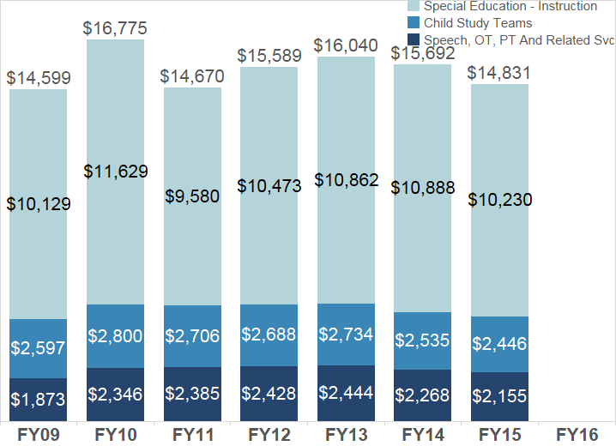
Special education spending per student

