Slide 1
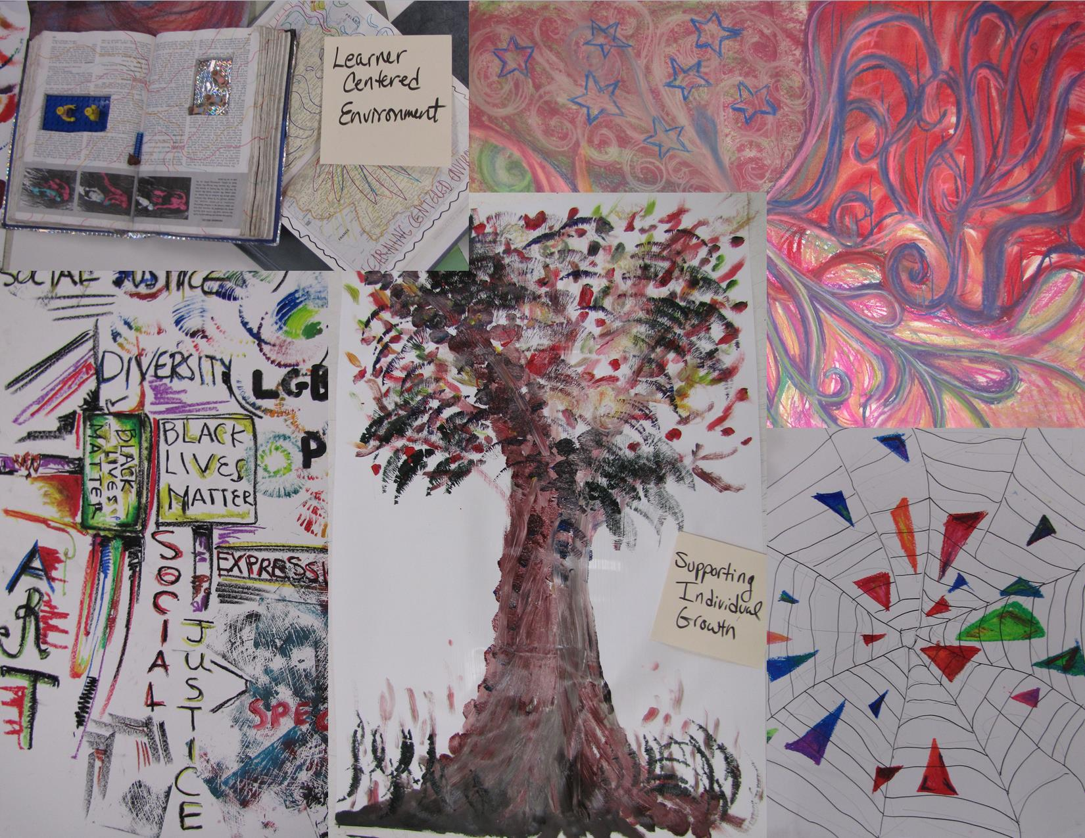
SOMSD Strategic Plan
Overview for Board of Education
November 21, 2016

Slide 2
Strategic Planning Process
12 steps of Strategic Planning
6. Train action planning teams
2. Synthesize data
4. Communicate Strategic Direction
3. Create Strategic Direction
5. Recruit Action Planning Teams
1. Collect Data
8. Action plans presented to strategic direction committee
10.Prioritize Plans & Create Implementation Schedule
12. Feedback Loop
9. Full Plan submitted to Board
11. Implement
7. Action teams meet
We are here
South Orange Maplewood School District
525 Academy Street • Maplewood, NJ 07040
www.southorangemaplewood.org

Slide 3
The Context
The Strategic Plan will serve as the blueprint to guide the District’s work for the next 3-5 years.
Multi-phase process, with a wide variety of perspectives included in every step along the way.
Collaborative effort so that the plan ultimately represents the values of our community and the needs of our students.
Notes:
John Ramos

Slide 4
The Charge
We have been engaging the community in thinking about education differently:
Think about what we need to do as a school system to prepare students for a future that we have yet to imagine.
How do we move away from trying to recreate an old system to creating a new system?
How do we move away from a system created for needs of the industrial era to a system that leads our society into and through the information era?
How do we deliver 21st Century learning in a fiscally hemorrhaging environment?
Notes:
John Ramos

Slide 5
Synthesis of Data from Education Summit
An overarching theme emerged from the Education Summit and other community engagement activities in Fall 2015. Consistently, we heard that parents, students and staff want to see:
A paradigm shift from fitting students and families into currently established structures and systems to structuring programs, services, outreach and communications to meet the needs of students and families.
Notes:
John Ramos

Slide 6
Strategic Direction
Members from across the community – teachers, administrators, students, parents, and outside educational experts – came together to co-create this document, which sets the vision and direction for the district’s new Strategic Plan.
This document was accepted by the Board of Education in February 2016.
It included 9 Strategies – broad statements which represent ideas in which SOMSD is willing to invest energy, expertise, time and resources to advance towards our mission.
Notes:
John Ramos

Slide 7
SOMSD’s Mission
The mission of the South Orange Maplewood School District is to empower and inspire each student to explore and imagine, to pursue personal passions, and to collectively create a better future by creating a learner-centered environment through multiple pathways; reimagined structures, systems and supports; innovative teaching; partnering with families; and maximizing community expertise and resources.
Notes:
Mara Rubin

Slide 8
Action Planning
Action Planning teams were formed for each of the 9 strategies developed by the Strategic Direction Committee.
Community members were invited to apply, and key partner organizations were invited to nominate members.
Team members were selected by administrators based on qualifications, how they best aligned with specific strategies, and to balance perspectives and experience.
The teams included educators, parents, students, and other community members who volunteered to share their passion for innovative education and commitment to the very best for SOMSD.
The teams met for 9 months to develop Action Plans – implementation steps for each strategy consisting of reasonable pieces of work that move us towards the mission.
Notes:
John Ramos

Slide 9
Student Involvement
“We value students as our primary stakeholders and at the heart of every decision”
Education Summit 1 – Students were involved as organizers, promoters, and participants.
Student Forums – Special opportunities for students to share their hopes and concerns.
Strategic Direction Committee - 4 student members helped co-create the vision and mission for the District.
Students served on the Action Planning teams for:
Curriculum, Instruction and Assessment
Multiple Student Supports
Student Engagement
Note – This Action Planning Team held focus groups with students

Slide 10
What are Action Plans?
Action Plans describe the work to be done to accomplish each of the strategies of the Strategic Direction.
The complete set of Action Plans addresses each of the Strategic Direction components, taken collectively.
The work described in the action plans will be accomplished over the next three to five years.
Notes:
Maudjah Francis

Slide 11
What is a Deliverable?
A deliverable is something that must be done to accomplish a strategy.
A deliverable is a product or service that must be done to accomplish a strategy.
It represents one of many smaller, more focused pieces of work, that once achieved will help to accomplish each strategy.
It represents smaller, more focused pieces of work that generally can be accomplished within a year and sometimes within a period shorter than a year.
It is measurable or can be demonstrated or observed.
A deliverable represents a “to do.”
Notes:
Mara Rubin

Slide 12
Deliverables Created by SOMSD
Action Planning Teams

Slide 13
Strategy 1: Curriculum, Instruction and Assessment
We will redesign curriculum, instruction and assessment to support learner-centered environments (e.g. reimagining seat time, multiple pathways, competency standards).

Slide 14
Strategy 1 Action Planning Team Members
Member | Affiliation
Susan Grierson, Co-Chair | Assistant Superintendent for Curriculum & Instruction, SOMSD; Member of Strategic Direction Committee
Jennifer Serravallo, Co-Chair | Parent; Author; Literacy Consultant
Melissa Comerchero | Parent; Math Educator
Angela Forero | Parent; Teacher, South Orange Middle School
Margaret Freedson | Parent; Professor, Department of Early Childhood, Elementary and Literacy Education at Montclair State University
Andrew Lee | Parent; Editor and Writer for Understood.org
Rachel Potts | Teacher, South Mountain Elementary School
Filip Saulean | CHS Student, Student Representative to the Board of Education, Member of Strategic Direction Committee
Marisa Stoessel | Teacher, Jefferson; Member of Strategic Direction Committee
Scott Stornetta, Ph.D. | Teacher, CHS; Member of Strategic Direction Committee
Nicola Vitale | Parent; Instructional Specialist Supporting STEM Education in NYC Schools

Slide 15
Curriculum, Instruction and Assessment Deliverables
1.1: Involve students in the assessment process
1.2: Integrate elementary curriculum across science/social studies
1.3: Create inquiry-based middle school math classrooms
1.4: Pilot mastery-based learning in a coding-infused math curriculum
1.5: Establish consistency in secondary writing instruction
Notes:
1.3 Can we consider changing this to “Create inquiry-based middle school math lab classrooms”

Slide 16
1.1 Involve Students in the Assessment Process
Establish and implement formative assessment methods that involve students in the assessment process including: goal-setting conferences, portfolio-based assessments, and student-led conferences.

Slide 17
1.2 Integrate elementary curriculum across science/social studies
Develop one integrated content unit per grade level, organized around national subject area standards, to be piloted in each of grades K-5.

Slide 18
1.3 Create Inquiry-Based Middle School Math Classes
Implement lab classrooms in the middle school to identify, model, and develop instructional practices, and materials that create learner-centered environments with a focus on inquiry-based instruction and cooperative learning.
Notes:
1.3 Can we consider changing this to “Create inquiry-based middle school math lab classrooms”

Slide 19
1.4 Pilot mastery-based learning in a coding-infused Math curriculum
Implement math courses to support learner-centered (mastery-based) learning of relevant curriculum.

Slide 20
1.5 Establish Consistency in Secondary Writing Instruction
Establish consistent goals, shared curriculum units and assessment procedures for secondary writing instruction that enhance opportunities for personalized learning and the development of high-level writing skills for all students.

Slide 21
Strategy 2: Multiple Student Supports
We will develop multiple supports for students to thrive in a learner-centered environment (e.g. mentoring program, peer leadership, individualized academic/ emotional support, transitional services, restorative practices and guidance in pursuit of their passions).

Slide 22
Strategy 2 Action Planning Team Members
Member | Affiliation
Karen Weiland, Co-Chair | Director of SOMSD Parenting Center; Elementary School Social Worker and Field Supervisor, SOMSD
Tamara Steckler, Co-Chair | Parent; Attorney-in-Charge of The Legal Aid Society's Juvenile Rights Division in NYC
Marc Gold, Co-Chair | Assistant Principal, Maplewood Middle School; Member of Strategic Direction Committee
Ann Bodnar | Principal, Clinton Elementary School
Brenda Ehlers | Parent; Children/Youth Pastor; Developer of After School Programming
Nikolin Eyrich | Parent; Educator
Kate Facto | Parent; Teacher, Special Education; Certified School Counselor
Valerie Frost | Parent; School Social Worker
Sabine Hack, M.D. | Parent; Child and Adolescent Psychiatrist
Marcia Hicks | CHS Guidance Counselor & Advisor to MAC Scholars
Jenny Lindstrom | Parent; SEPAC President; Nonprofit Consultant
Xavier Parks | CHS Student, MAC Scholar
Angel Medrano | CHS Student, MAC Scholar

Slide 23
Multiple Student Supports Deliverables
2.1: Develop and link a school-wide peer mentorship and advisory program (MAP) for secondary students
2.2: Develop standardized, district-wide restorative practices
2.3: Create high-quality extended-day programming.
2.4: Create a counseling internship program at CHS.
2.5: Standardize and strengthen the Information &Referral System process.
2.6: Incorporate play/innovation period into elementary and middle school class time
2.7: Develop a one-stop hub of services for families.

Slide 24
DELIVERABLE 2.1
Develop and link a school-wide peer mentorship and advisory program (MAP) for secondary students to strengthen students’ sense of belonging to the school community and improve their academic achievement, creating a cultural shift from tolerance to open acceptance of our differences.

Slide 25
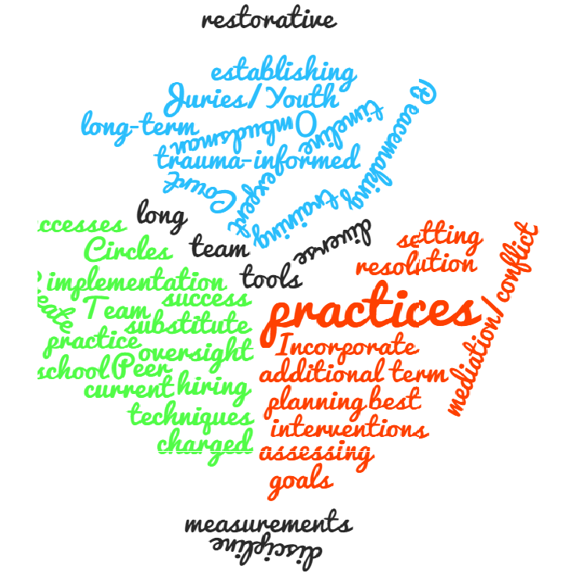
DELIVERABLE 2.2
Develop standardized, district-wide restorative practices, including Restorative Justice (RJ), that help students and staff resolve conflicts peacefully and respectfully, reduces punitive discipline and helps decrease racial discipline disparities.

Slide 26
DELIVERABLE 2.3
Create high-quality extended-day programming that is highly integrated with school-day learning and includes enrichment, academic support, and before- and after-school care.

Slide 27
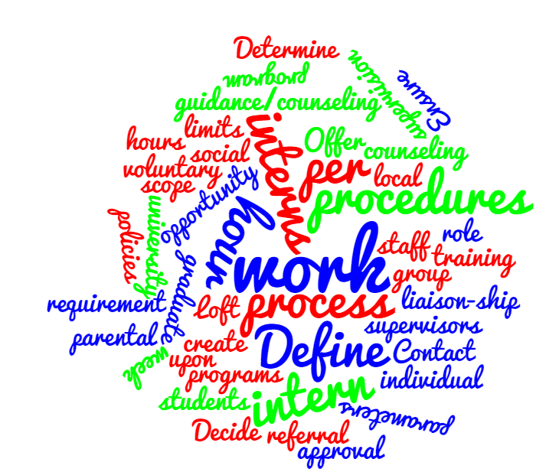
DELIVERABLE 2.4
Create a counseling internship program at Columbia High School to support students’ social/emotional growth and academic success

Slide 28
DELIVERABLE 2.5
Create a seamless system of support within schools and across the district for students and teachers by standardizing and strengthening the Intervention &Referral Services (I & RS) process.

Slide 29
DELIVERABLE 2.6
Incorporate play/innovation period into elementary class time to diminish school-related stress and promote the joy of learning, support free-play and encourage exploration, imagination, and student connections.

Slide 30
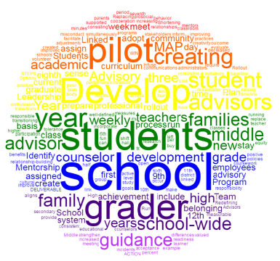
DELIVERABLE 2.7
Develop a one stop hub of services connecting district families to legal, health and community social service supports, including food stamp providers, legal support, food programs, health care providers, public benefits providers, etc. who will provide their services pro bono.

Slide 31
STRATEGY 3: Student Engagement
We will work with students
to redefine their roles
as active and engaged contributors to the learning experience in their
schools and communities.

Slide 32
Strategy 3 Action Planning Team Members
Member | Affiliation
Kerith Lewis, Co-Chair | Parent; Professional Educator
Nina Kambili, Co-Chair | CHS Student, Student Representative to the Board of Education, Member of Strategic Direction Committee
Rhea Beck | Community Member
Erendira Casella | Parent
Nini Heriveaux | CHS Student, MAC Scholar, Member of Strategic Direction Committee
Julia Leider | Teacher, Columbia High School
Vanessa Proietto | Teacher, Marshall School
Erica Schwartz-Hall | Parent; Homeschool Parent Leadership Coach
Sonya Selig | Parent, Special Education PTO Executive Committee
Philip Stern | In-House Counsel, SOMSD

Slide 33
STUDENT ENGAGEMENT DELIVERABLES
3.1. Implement a pilot CommUNITY system within Seth Boyden Elementary School to serve as a model for a future district-wide program.
3.2. Create and implement a Middle School Intramural Sports program at Maplewood and South Orange Middle Schools.
3.3. Create a three week Extra-session pilot program at Columbia High School, in collaboration with students, staff, and community members.
3.4. Implement a district-wide sustainable Social and Emotional Learning Initiative.
3.5. Create, distribute, and analyze Engagement Surveys of all staff, students, and parents within the community, and implement changes to increase engagement for all.

Slide 34
3.1 CommUNITY System
Create communities which empower students and teachers, build relationships and trust, and promote strong emotional and social connections between students on a multi-age level.

Slide 35
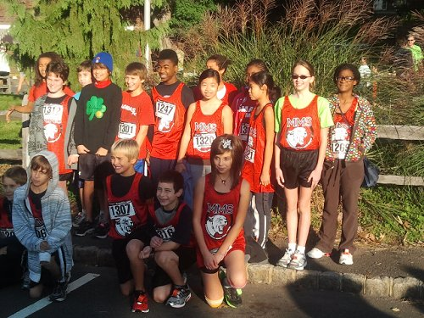
3.2 Intramural Sports
Support overall student growth with an intramural sports program that ensures increased participation across race, income-level and gender, and promotes a healthy life-school balance.

Slide 36
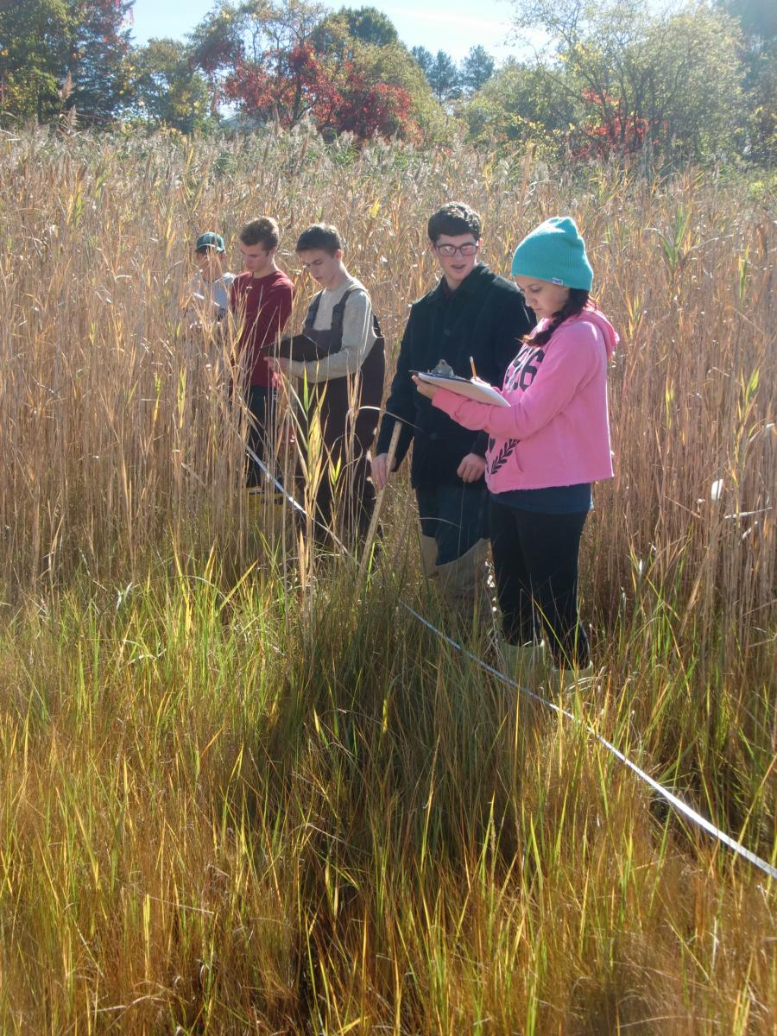
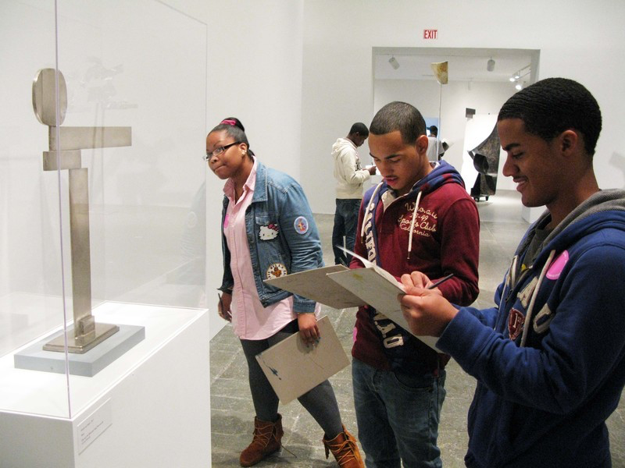
3.3 Extra-session
Implement an opportunity for students to collaborate in the development of their own curriculum, which will lead to a sense of empowerment and responsibility for their own education.

Slide 37
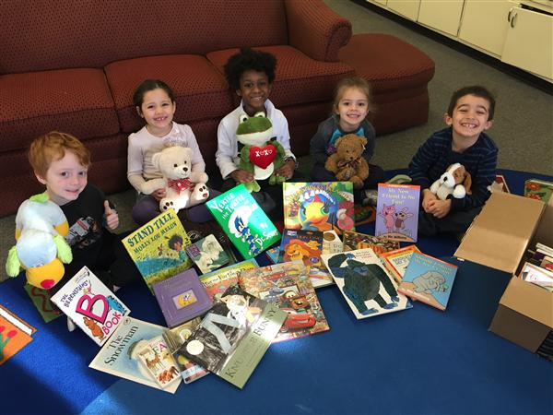
3.4 Social Emotional Learning Initiative
Advance social and emotional skills for students and staff within the context of safe, caring, well-managed and engaging learning environments.

Slide 38
3.5 Engagement Survey
Work in partnership with students, teachers, & parents to understand the current climate of engagement.
Then create and innovate at a grass roots level to institute specific solutions.

Slide 39
STRATEGY 4: Professional Development
We will provide ongoing, differentiated and relevant professional development to grow teachers and administrators to theorize, critique, examine, and explore in order to engage every student in a learner-centered environment.

Slide 40
Strategy 4 Action Planning Team Members
Member | Affiliation
Donna Grohman, Co-Chair | Community Member; Instructional Specialist Language Arts K-5, SOMSD; Trustee, South Orange Public Library
Julia Sommer, Co-Chair | Parent; Teacher Trainer and Instructional Coach
Mara Rubin, Co-Chair (through May 2016) | Supervisor of Fine and Performing Arts, Member of Strategic Direction Committee
Jane Bleasdale, Ph.D., Co-Chair (through May 2016) | Parent; SEPAC Executive Committee Member; Educational Administrator/Consultant
Barry Bullis | Parent; Education Administrator, NYC Department of Education; Adjunct Assistant Professor, Pace University.
Sean Butkus | Parent
Thandi Center | Parent, NYC Director, New Teacher Center
Berit Gordon | Parent; Literacy Consultant
Joyce Leslie | Teacher, Columbia High School
Maureen O’Sullivan | Teacher, Maplewood Middle School
Scott Stornetta, Ph.D. | Teacher, CHS, Member of Strategic Direction Committee
Kirsten Widmer-Brash | Parent; Literacy Consultant

Slide 41
Professional Development Deliverables
4.1: Provide PD that promotes growth in the area of learner-centered classrooms
4.2: Create and utilize a continuum of exemplary learner-centered teaching.
4.3: Develop vertical curriculum alignment.
4.4: Provide experiential workshops.
4.5: Provide ongoing PD that is differentiated, job-embedded and responsive.
4.6: Establish a performance review process that incorporates feedback from multiple constituents.
Notes:
Deliverable 1: A framework/system of determining goals and PD plans for learner centered environment
Deliverable 2: Preparing school staff to plan curriculum that puts learner-centered instruction at its center, with district-wide cohesion
Deliverable 3: Differentiated professional development for administrators and teachers through various providers to promote a learner-centered focus.
Deliverable 4: Implementation of a 360 review process for all South Orange Maplewood School District administrators, teachers and staff

Slide 42
Deliverable 4.1
Provide Professional Development that promotes growth in the area of learner-centered classrooms, that incorporates a district-wide statement of beliefs.

Slide 43
Deliverable 4.2
Create and utilize a continuum of exemplary learner-centered teaching for SOMSD along which all educational professionals can identify their current status and determine next steps toward better learner-centered instruction.

Slide 44
Deliverable 4.3
Develop vertical curriculum alignment to leverage learner centered environments.

Slide 45
Deliverable 4.4
Secure resources to provide experiential workshops that model and involve teachers directly in learner centered instruction.

Slide 46
Deliverable 4.5
Provide ongoing professional learning opportunities for teachers and administrators that are:
differentiated
job embedded
& responsive
Facilitated by:
instructional coaches
School/district leaders
& teacher leaders
To promote individual professional growth, informed by:
Performance evaluation process
& district-wide priorities and objectives

Slide 47
Deliverable 4.6
Establish a performance review process that incorporates feedback from multiple constituents in order to identify individualized, ongoing, and responsive tailored professional development growth

Slide 48
Strategy 5:
Cultural Competency
We will infuse cultural competency in every aspect of our learning community.

Slide 49
Strategy 5 Action Planning Team Members
Member | Affiliation
Ramon Robles-Fernandez, Ph.D., Co-Chair | Supervisor of World Languages and ELL, SOMSD
Katerina Karis, Co-Chair | Teacher, South Orange Middle School
Walter Fields, Co-Chair | Parent; Journalist; SoMa Black Parents Workshop
Nancy Gagnier | Parent; Executive Director, Community Coalition on Race
Bibi Hayakawa | Parent; Member, Schools Committee, South Orange/Maplewood Community Coalition on Race
Thora Lee | Parent; Attorney, Mediator and Arbitrator
Laura Prato | Social Worker, Columbia High School
Amelia Nickles Riekenberg | Parent; Collaborative Attorney/Practitioner and Mediator; PTA Co-President of Seth Boyden
John Sarantakis | Parent of Marshall Students
Erin Siders | Parent; Member of SEPAC Executive Committee
Eric Stoudemire | Social Worker, Tuscan Elementary School

Slide 50
Cultural Competency Deliverables
5.1 Provide mandatory and ongoing professional development for all staff in issues relevant to cultural competency.
5.2 Develop protocol for hiring and retention that supports cultural competency objectives.
5.3 Provide students with ongoing, formal and informal opportunities for discussion to raise cultural awareness
5.4 Expand learning opportunities outside of the classroom
5.5 Provide students with access to curriculum that is culturally responsive.
5.6 Develop mechanisms to review district policies and procedures through the lens of cultural competency.
5.7 Identify, establish relationships and collaborate with community and regional organizations to develop and strengthen cultural competency.

Slide 51
Deliverable 5.1: Professional Development
Provide mandatory and ongoing professional development for all staff in issues relevant to cultural competency.

Slide 52
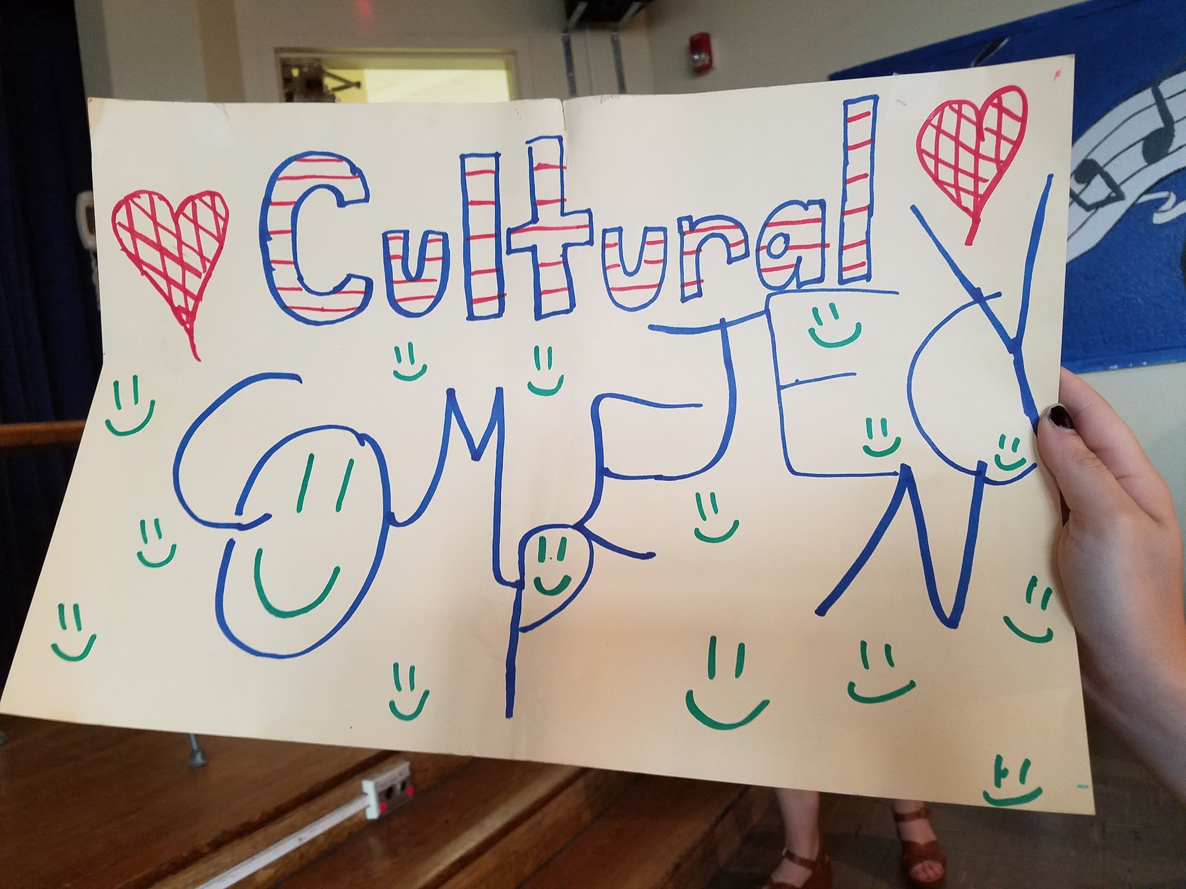
Develop protocol for hiring and retention that supports cultural competency objectives.
Deliverable 5.2: Hiring and Retention

Slide 53
Deliverable 5.3: Provide students with ongoing, formal and informal opportunities for discussion to raise cultural awareness Deliverable 5.4 Expand learning opportunities outside of the classroom
Deliverable 5.5 Provide students with access to curriculum that is culturally responsive.

Slide 54
Deliverable 5.6: Enforcement/
Accountability
Develop mechanisms to review district policies and procedures through the lens of cultural competency.

Slide 55
Deliverable 5.7: Partnerships
Identify, establish relationships and collaborate with community and regional organizations to develop and strengthen cultural competency.

Slide 56
We will partner with families in support of student growth
STRATEGY 6: Partnering with Families

Slide 57
Strategy 6 Action Planning Team Members
Member | Affiliation
Devyani Guha, Co-Chair | Parent; Urban Planner, Collective for Community Culture and Environment; Member of Strategic Direction Committee
Kimberly Hutchinson, Co-Chair | Principal, Jefferson Elementary School
Mike Barnett, Ph.D. | Parent; Professor of Strategic Management at Rutgers Business School
Courtney DeVomecourt | Parent; Teacher, South Mountain Elementary School
Amy Forman | Parent; Achieve Volunteer Tutor Program Coordinator
Irene Langlois | Parent; Head of Teen Services for Maplewood Memorial Library; Co-Chair of Achieve Foundation's STEAM Committee
Lara Pennington | Parent; Adjunct Writing Professor at Seton Hall Law School and University of Pennsylvania Law School
Alison Steiner | Parent; Social Worker, South Orange Middle School
Lorraine Sudol, M.A. & M.Ed. | Parent; Family/Child Therapist; Teacher, Jefferson Elementary School

Slide 58
Families Deliverables
6.1 EXPAND POWERSCHOOL FROM K-12 (UP TO DATE DATA)
6.2 AUGMENT FORMAL CHANNELS OF COMMUNICATION RELATED TO STUDENT GROWTH WITH MULTIPLE INFORMAL CHANNELS (REAL TIME SUPPORT)
6.3 CENTRAL WELCOME AND SUPPORT CENTER
6.4 STANDARDIZE COMMUNICATION WITHIN SCHOOLS

Slide 59
6.1 Up to date data
Utilize PowerSchool as the primary means of reporting information about student performance and growth for grades K-12 in the 2017-2018 school year.

Slide 60
6.2 Real time support
Augment formal communication tools related to student growth with multiple informal channels of outreach and engagement with the help of part time Parent Liaisons by answering questions in real time, providing parent to parent support opportunities, Community Advisory Committee and Parent/Family Academies

Slide 61
6.3 Central Welcome and Support Center
Develop and implement a centralized welcome and support system that is accessible to all families and fully promoted by the district as a resource for information and assistance.

Slide 62
6.4 STANDARDIZE COMMUNICATIONS WITHIN SCHOOLS ACROSS DISTRICT
Standardize outgoing communication within schools across the district both in terms of platforms used and content, as well as accessibility to ELL families.

Slide 63
We will reimagine and redesign all aspects of student scheduling, use of facilities and administrative structures to guarantee alignment with mission.
Strategy 7: Scheduling, Facilities, Administrative Structures

Slide 64
Strategy 7 Action Planning Team Members
Member | Affiliation
Kevin Walston, Co-Chair | Assistant Superintendent for Administration, Member of Strategic Direction Committee
Allan Tumolillo, Co-Chair | Community Member; Teacher, Columbia High School; Member, Board of Trustees of Achieve Foundation, CHS Cougar Boosters, CHS Scholarship Fund
Howard Fineman | Parent; Professional Educator
Jamie Gulotta | Teacher, Maplewood Middle School
Melanie Hochberg Giger | Parent; Former NYU professor, Professional Educator and Instructional Designer
Jennifer Latimer | Parent; Teacher and Media Specialist, Clinton Elementary School
Michelle Lederman | Parent; Professional Educator
Aileen Nicoletti, Ph.D. | Parent; Co-Chair of Achieve Foundation's STEAM Committee
Bonita Samuels | Parent; Principal, Marshall Elementary School

Slide 65
Scheduling, Facilities and Admin Structures Deliverables
7.1: Create a daily and weekly schedule and an annual calendar to allow for intense academic study, experiential learning, and community-based activities.
7.2: Configure learning areas with furniture, tools, equipment and technology to accommodate fluid, learner-centered exploration and cross disciplinary instruction.
7.3: Create a plan for district / school facilities to allow for greater capacity and modern working environments.
7.4: Create and communicate structures and processes that allow for multiple pathways for all learners to access a rigorous and relevant education.

Slide 66
Deliverable 7.1
Create a daily and weekly schedule and an annual calendar to allow for intense academic study, experiential learning, and community-based activities.

Slide 67
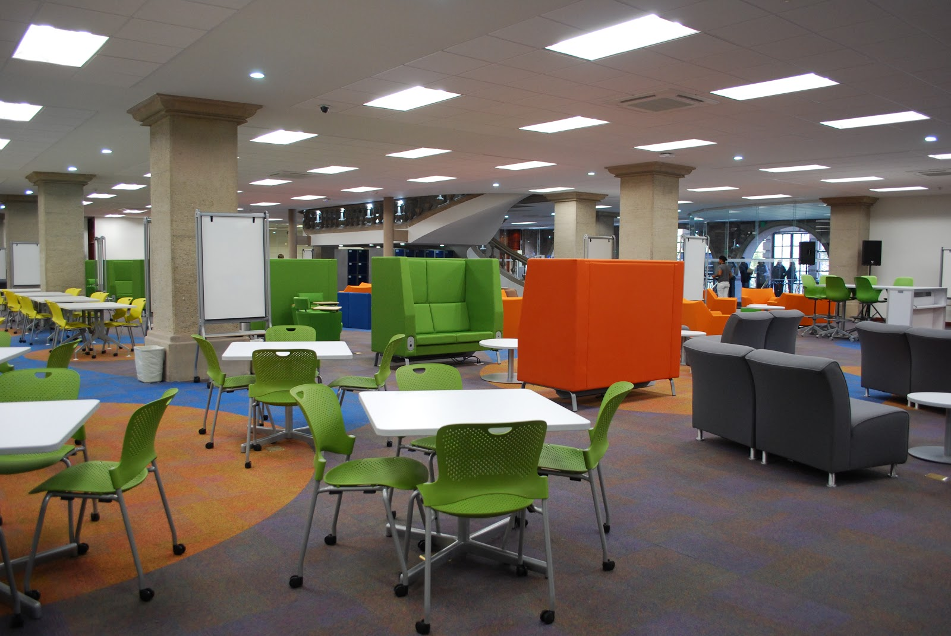
Deliverable 7.2
Configure learning areas with furniture, tools, equipment and technology to accommodate fluid, learner-centered exploration and cross disciplinary instruction

Slide 68
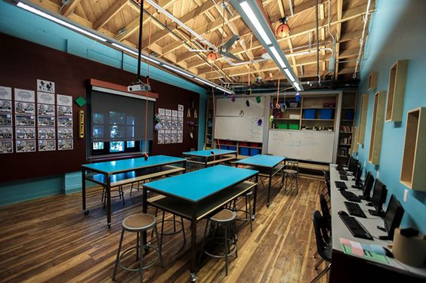
Deliverable 7.3
Create a plan for district/school facilities to allow for greater capacity and modern working environments

Slide 69
Deliverable 7.4
Create and communicate structures and processes that allow for multiple pathways for all learners to access a rigorous and relevant education

Slide 70
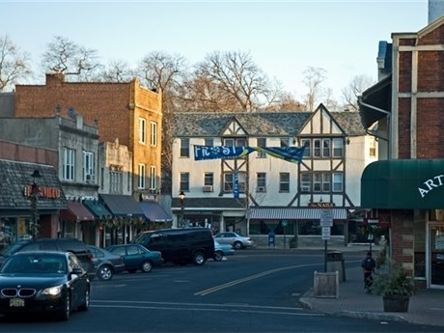
Strategy 8: Community
We will maximize community expertise and external resources to provide multiple pathways for student and professional growth and learning.

Slide 71
Strategy 8 Action Planning Team Members
Member | Affiliation
Peri Smilow, Ed.M., Co-Chair | Parent, Singer/Songwriter, Community Educator, Member of Strategic Direction Committee
Terry Woolard, Co-Chair | Assistant Principal, Columbia High School
Yolande Fleming, Co-Chair | Teacher, Clinton Elementary School, Member of Strategic Direction Committee
Barbara Cokorinos | Parent; Administrator/Adjunct Teacher, NYU, Tisch School of the Arts; Co-President, CHS Music Parents' Association
Renee Joyce | Director of Montrose Early Childhood Center
Kris Knutsen, M.A. | Parent
Maggie Marotta | Parent; Professional Educator
Robin Burns Saunders | Parent; Co-Founder and Chief Operating Officer for the Innovation Studio of Manhattanville, Inc.
Mauri Solages | Parent; Corporate Giving Professional; Board Member of AmeriCorps Organization
Marcy Thompson | Parent; Chair, Maplewood Arts Council; Director of Studio B

Slide 72
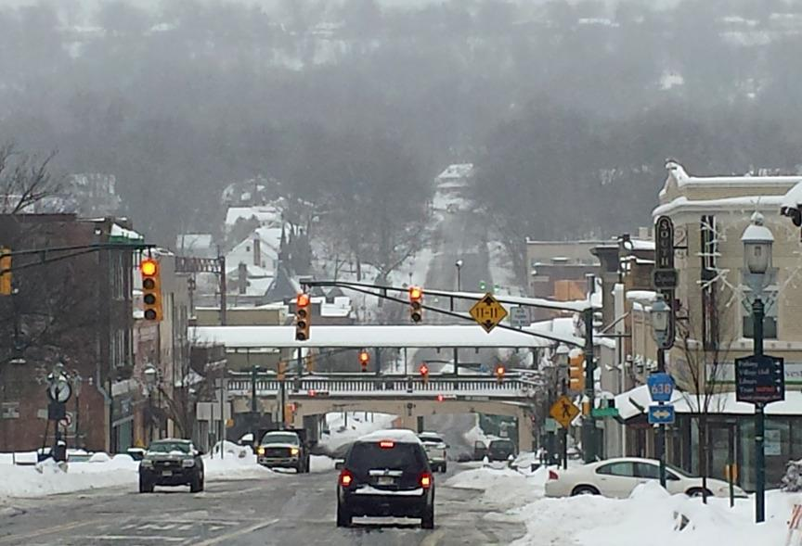
Community Deliverables
8.1: Create a brick and mortar, student-managed Community Storehouse to provide free,
innovative learning materials to teachers and students
8.2: Develop SOMSD Experts in Action, a collective of local adult volunteers who interface with the school community in innovative and meaningful ways that enhance teaching and learning
8.3: Design and implement a district-wide, K-11,
Community Service Learning requirement
8.4: Design an accredited Internship program with
mentorship for high school seniors

Slide 73
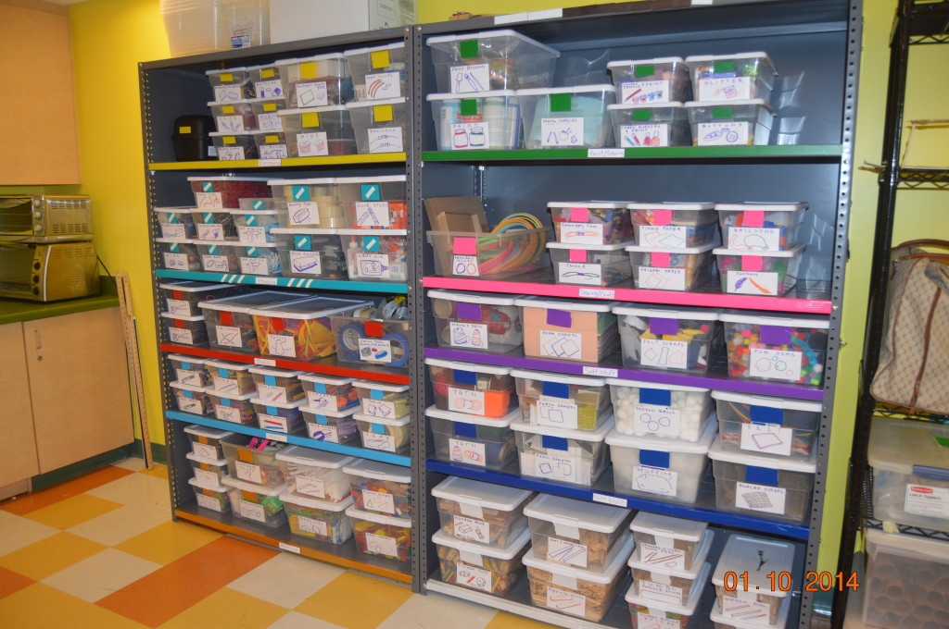
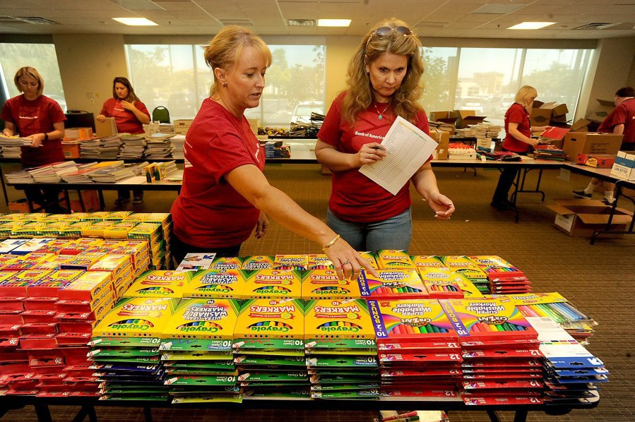
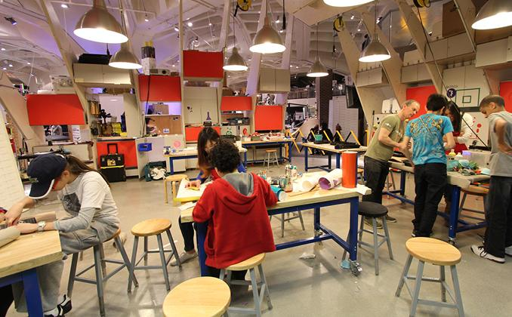
Deliverable 8.1
Create a student-managed Community Storehouse that channels a wide range of creative materials from local donors and businesses to students, teachers and staff throughout the district. Teachers will visit the Storehouse to procure supplies that will enhance their teaching and support classroom innovation.

Slide 74
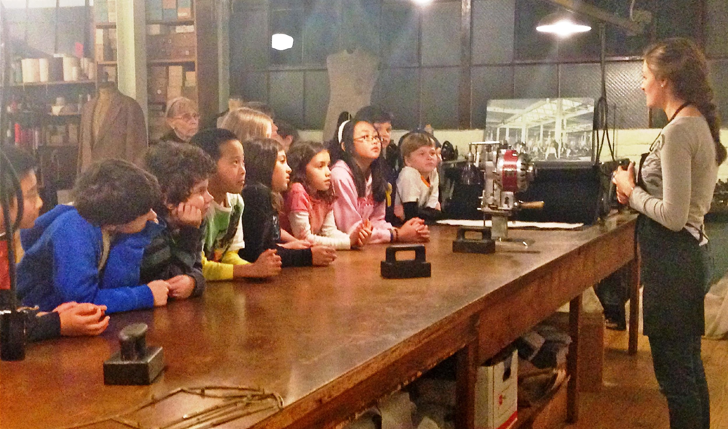
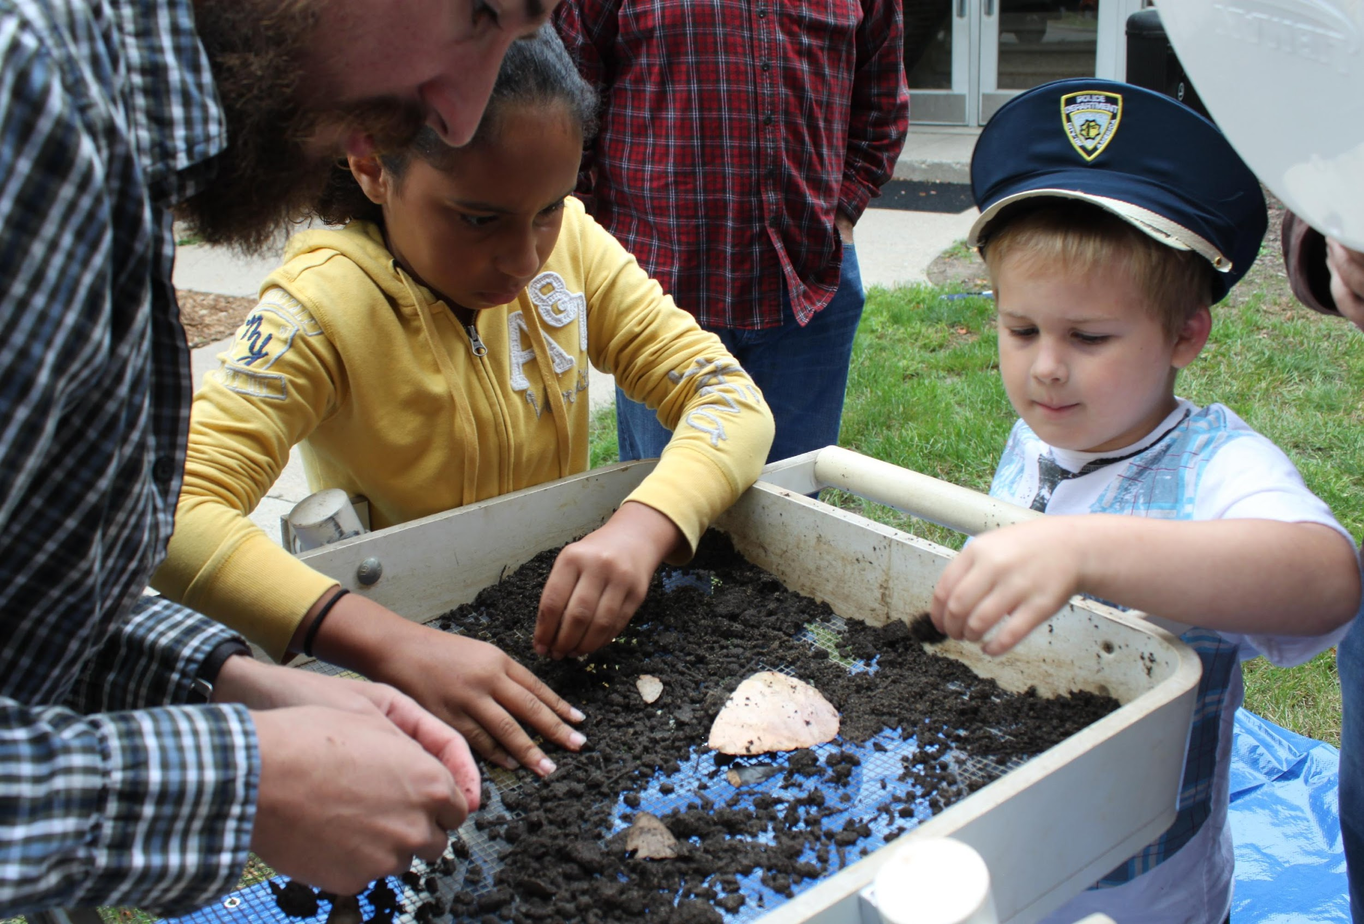
Deliverable 8.2
Develop SOMSD Experts in Action, a resource for students (K-12) and staff. These highly engaged adult volunteers will serve the district in a variety of capacities: as content “experts” who provide an invaluable asset that enhances curricula; as cross-disciplinary teams who provide a 360-degree view of topics; as providers of career guidance; and as connection to “real-world” perspective by ensuring that the district has insight into current trends shaping markets and industries.

Slide 75
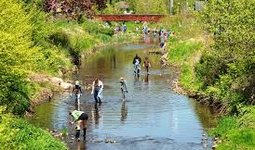
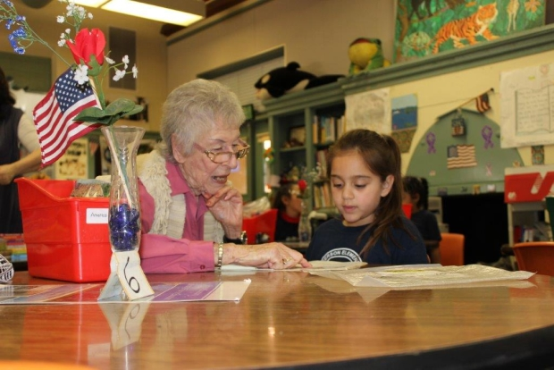
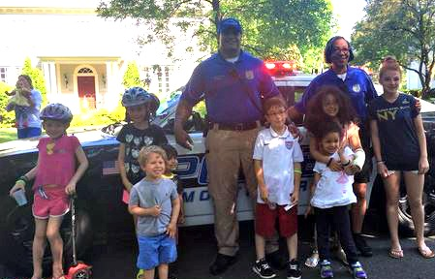
Deliverable 8.3
Design and implement a district-wide Community Service Learning requirement as an intentional instructional strategy to meet learning goals and content standards, to promote diversity, to deepen critical thinking, to sharpen analytical skills and to meet community needs resulting in increased civic engagement in grades K-11.

Slide 76
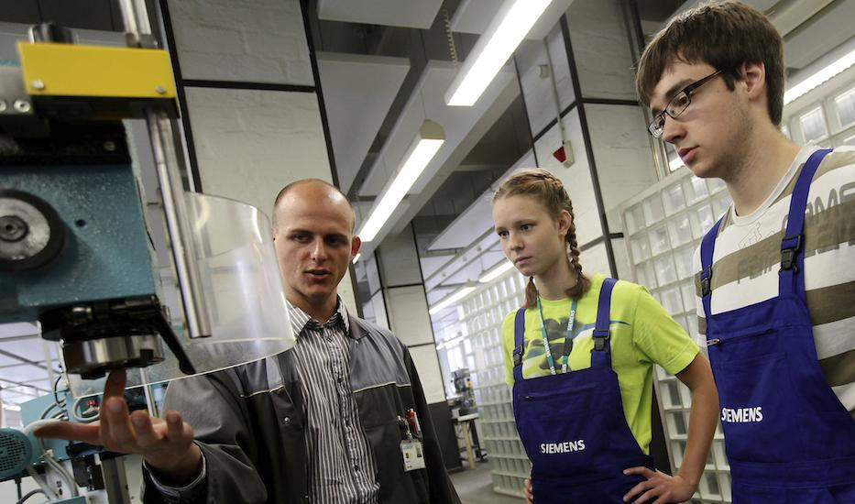
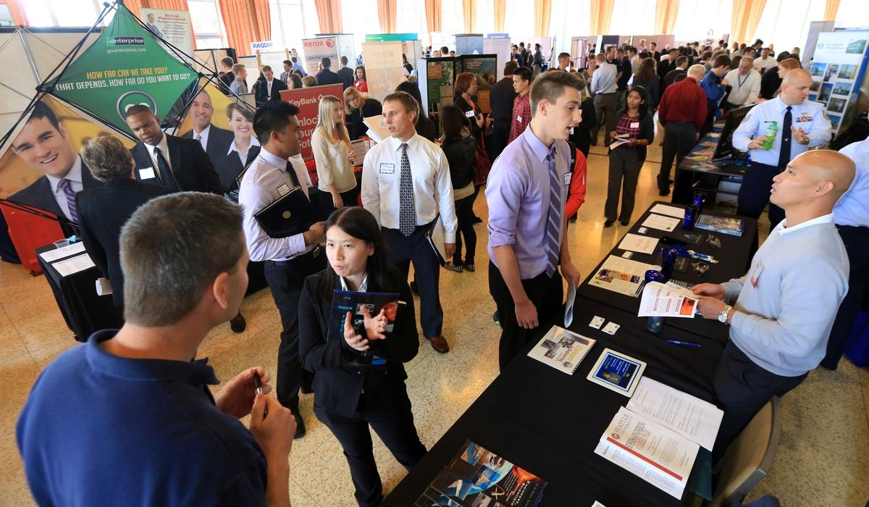
Deliverable 8.4
Create the Senior (High School) Internship Project: a semester-long, one-credit course culminating in a four week internship at a local organization or business to provide diversified learning experiences that “bridge the gap” between school and employment/higher education/training and build on previous service learning experience.

Slide 77
Strategy 9: Communications
We will engage in robust, open, ongoing and transparent communications with all students, families, staff and community members to generate understanding, excitement, trust and support of our school community and its transformation.

Slide 78
Strategy 9 Action Planning Team Members
Member | Affiliation
Audrey Rowe, Co-Chair | Program Director, South Orange/Maplewood Community Coalition on Race, Member of Strategic Direction Committee
Suzanne Turner, Co-Chair | Parent; Director of Strategic Communications
Susie Adamson | Parent; Presidents' Council Co-President; Real Estate Agent
Paul Bartick | Parent; Communication Consultant
Amanda Eigen | Parent; Librarian at Maplewood Memorial Library
Sara Goetz | Parent; Attorney
Shayna Sackett-Gable | Parent; Teacher, Seth Boyden Elementary School

Slide 79
Communications Deliverables
9.1: Interactive communications plan about the strategic planning process and implementation.
9.2: Pilot interactive outreach to secondary school parents/guardians
9.3: Pilot an aggressive outreach to underrepresented populations.
9.4: Begin development of an information portal.

Slide 80
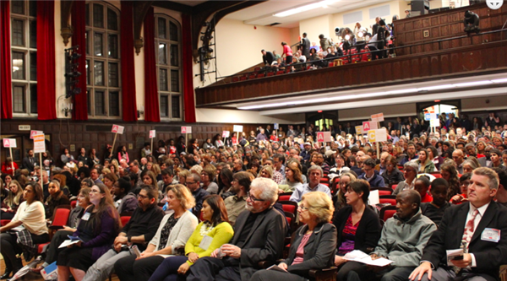
Deliverable 9.1
Create communications plan that interacts with and engages every stakeholder in a community-wide dialogue about and stimulates support for the strategic planning process.

Slide 81
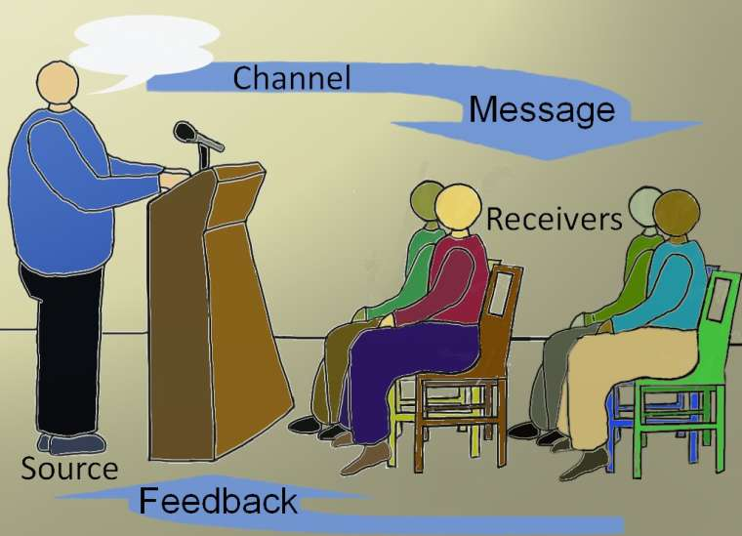
Deliverable 9.2
Devise a process that engages every secondary school parent/guardian in an interactive communication with the South Orange-Maplewood School District at least once per marking period.

Slide 82
Deliverable 9.3
Pilot an aggressive two-way program to identify and communicate to underrepresented populations as a starting point for achieving 100% stakeholder engagement.

Slide 83
Deliverable 9.4
Develop a plan to identify communication needs of the SOMSD Community, determine how a portal can help create solutions, and begin the development process.
Single sign on!
Search for School Info!
PowerSchool!
Teacher Web sites!

Slide 84
What the Board Is Being Asked to Do
Adopt the Strategic Direction, including the Mission Statement
Accept the Action Plans, and acknowledge the tremendous work of the volunteer action planning team members.
Authorize Administration to carry out the next steps of the Strategic Planning Process:
Prioritize Plans, incorporating input from Board and community
Create an Implementation Schedule for Year 1, and align to the 2017-2018 budget. This budget will incorporate these first year initiatives. Both the 2017-2018 budget and the Year 1 Implementation Plan will be adopted by the Board of Education in March 2017.
Create a 3 Year Implementation Schedule, which will be incorporated into annual district goals, along with other priorities, and adopted by the Board of Education as part of the district goal setting process.

Slide 85
Opportunities to Learn More
Date | Event | Location
Tues., Dec, 6, 2016 7:00pm – 9:30pm | Education Summit 2 | Columbia High School
Mon., Dec. 12, 2016 3:30pm – 4:30pm | Staff Forum | Montrose
Wed., Dec. 14, 2016 9:00am – 10:00am | Community Forum | Montrose
Mon., Dec. 19, 2016 7:30pm – 11:00pm | Board of Education Meeting – Vote to: Adopt Strategic Direction Accept Action Plans Authorize Administration to Create Implementation Schedule | Columbia High School

Slide 86
Community Feedback
We invite community input into which deliverables you believe are the most urgent, or have the greatest potential for change, and would like to see implemented early in the process.
http://tinyurl.com/SOMSDStrategic

