Slide 1
PARCC Results
Spring 2018 Administration
Measuring College and Career
Readiness
South Orange-Maplewood
Public Schools
September 17, 2018
1

Slide 2
NEW JERSEY’S STATEWIDE ASSESSMENT PROGRAM
2018 marks the 4th administration of the Partnership for Assessment of Readiness for College and Careers (PARCC)
and the second oppor tunity to compare year-to-year results.
Students took PARCC English Language Ar ts and Literacy
Assessments (ELA/L) in grades 3 – 11 .
Students took PARCC Mathematics Assessments in grades 3 – 8 and in Algebra I, Geometry, and Algebra II.
As of May 2018, HS Graduation requirements are related to PARCC (ELA 10 and Algebra I), but continue to be revisited by the NJDOE
2

Slide 3
PARCC PERFORMANCE LEVELS
Level 1: Not yet meeting grade-level expectations
Level 2: Partially meeting grade-level expectations
Level 3: Approaching grade-level expectations
Level 4: Meeting grade-level expectations
Level 5: Exceeding grade-level expectations
3

Slide 4
State Averages vs. SOMSD Averages

Slide 5
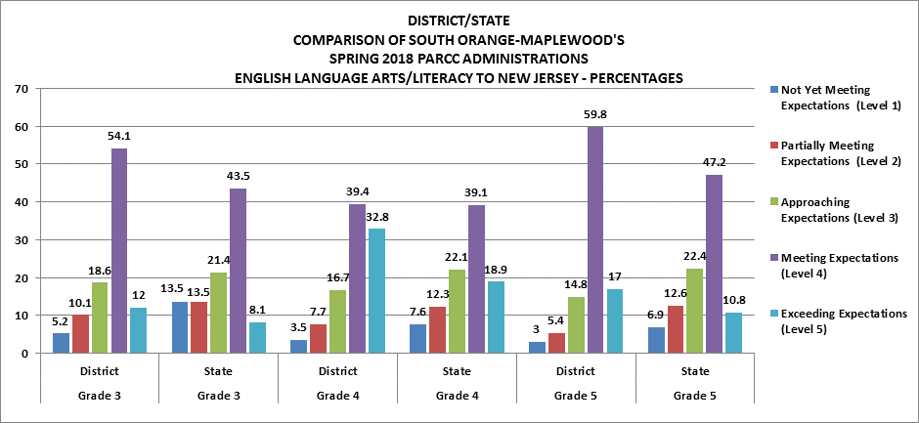
For most grades SOMSD has a fewer % of students scoring level 1, 2 or 3, and a higher % of students scoring 4 &5.

Slide 6
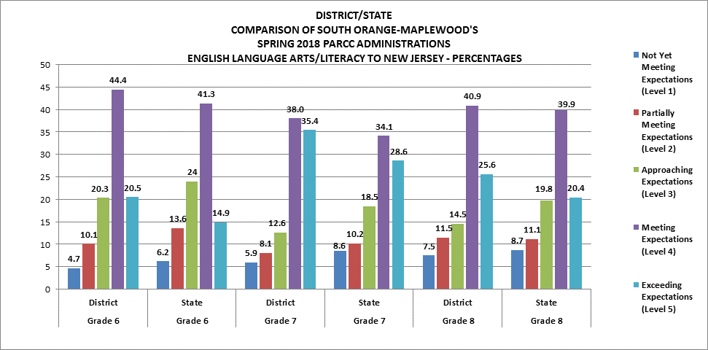
Our middle school students met/exceeded the state average across all grade levels.

Slide 7
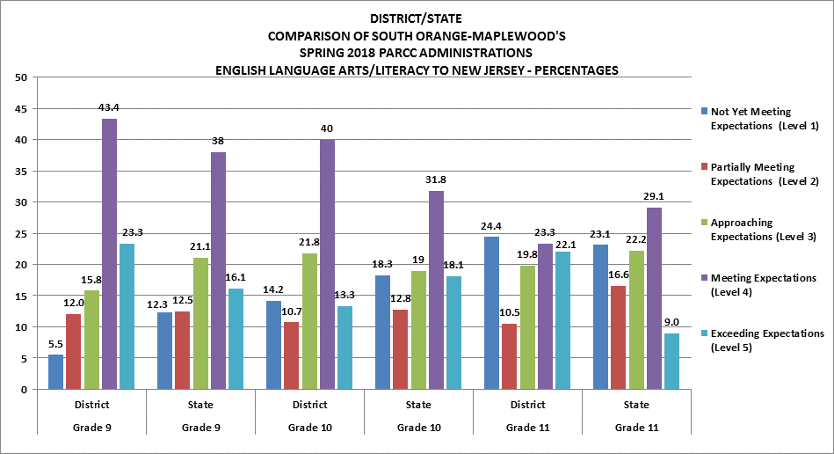
Many students in the 11th grade students at CHS did not participate in the PARCC assessments.

Slide 8
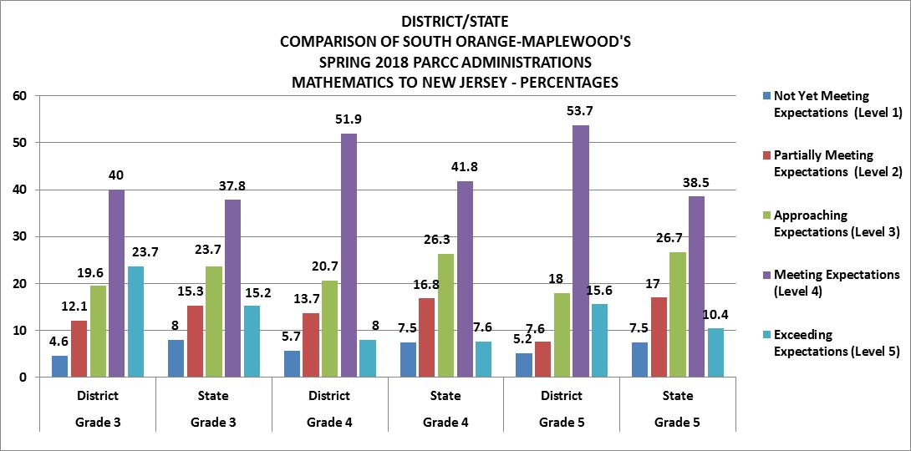
The trend continues in math (except 8th) SOMSD has a fewer % of students scoring level 1, 2 or 3, and a higher % of students scoring 4 &5.

Slide 9
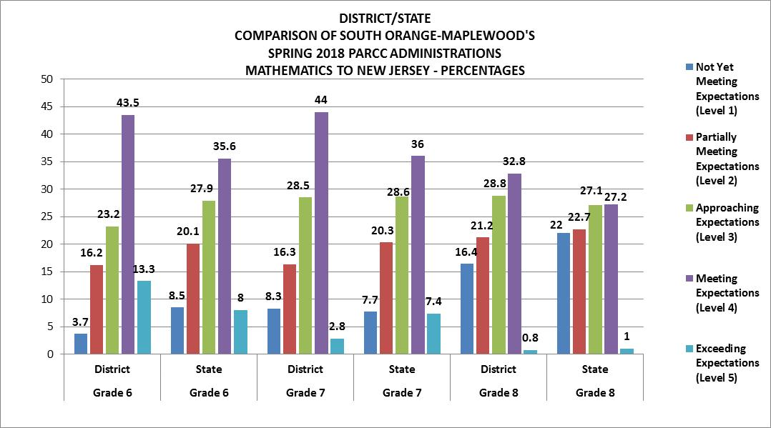
For 8th grade, SOMSD has a higher % of students scoring level 1 and level 2 than the state average. This is not reflective of our 8th grade class as it does not include 8th graders taking Algebra or Geometry.

Slide 10
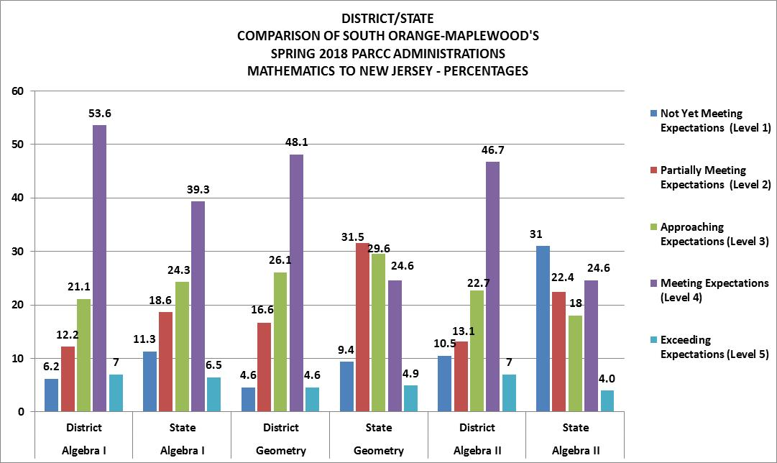
SOMSD performs significantly better than the state in Algebra I, Geometry, and Algebra II.

Slide 11
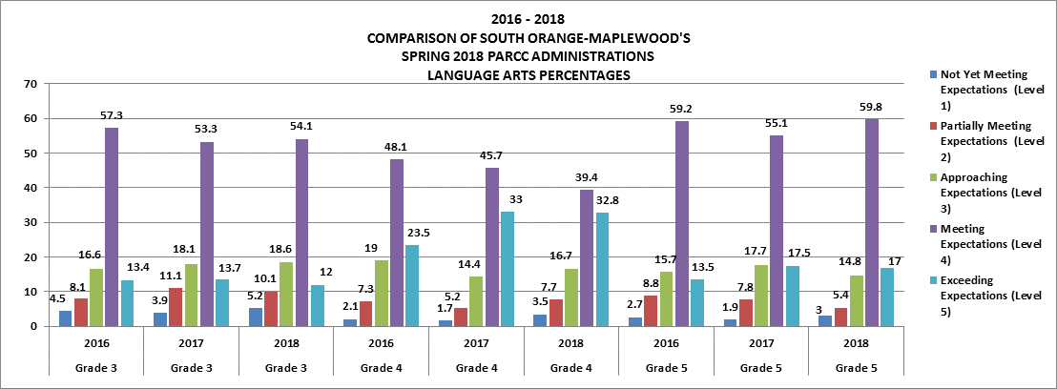
Year over year the % of students meeting or exceeding expectations have remained consistent. There was a slight increase in 4th grade and 5th grade.

Slide 12
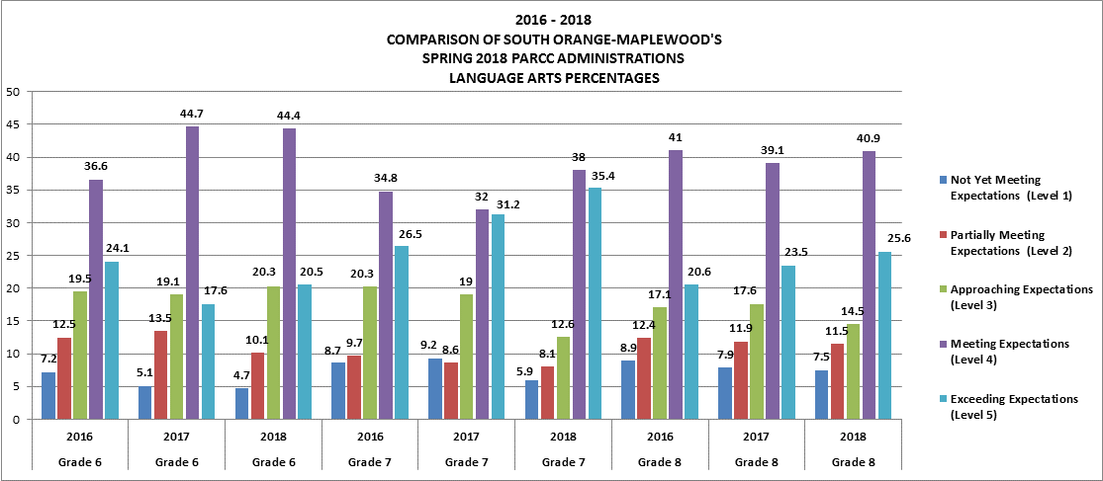
There was a 10% increase in 7th grade ELA in the past 2 years.

Slide 13
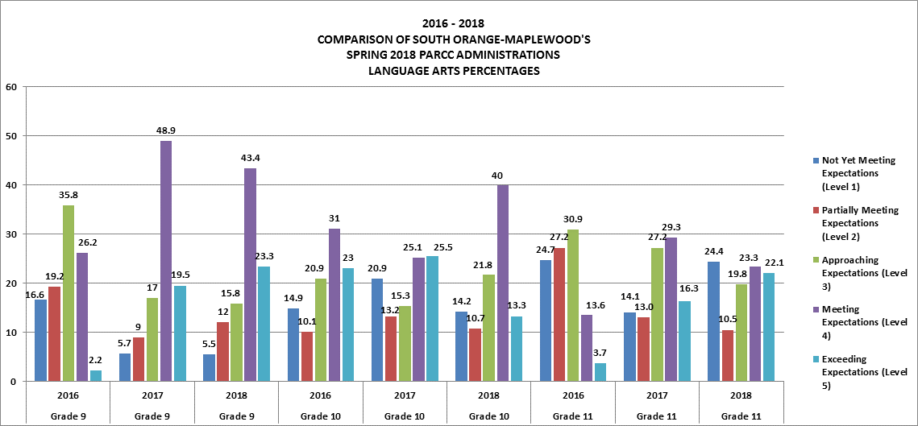

Slide 14
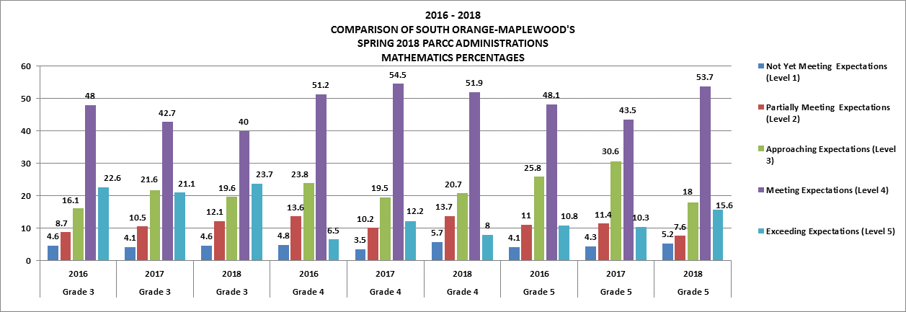

Slide 15
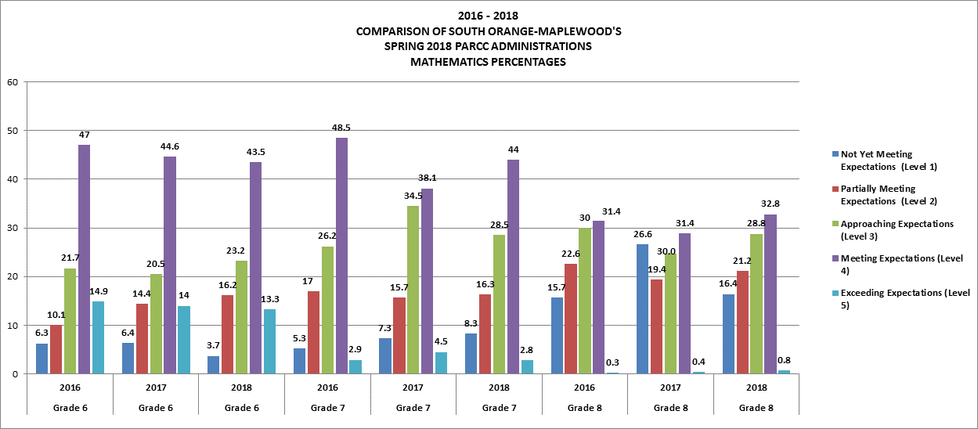

Slide 16
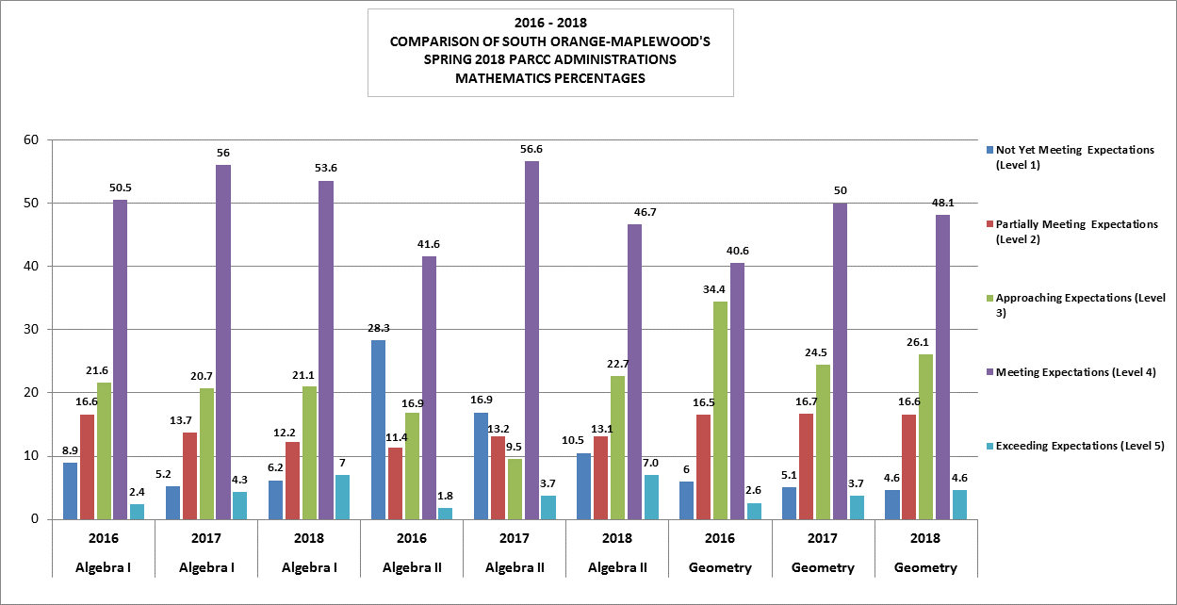

Slide 17
District Highlights
SOMSD’s percentage of students meeting or exceeding grade level expectations in ELA in ALL grades are higher than the state average.
SOMSD’s percentage of students meeting or exceeding grade level expectations in Math in grades 3-10 and levels are higher than the state average.
Maplewood Middle School- 93.6% of students met or exceeded expectations the ALG. I PARCC and 83% of students met or exceeded expectations on the Geometry PARCC
South Orange Middle School- 88.1% of students met or exceeded expectations on the ALG. I PARCC and 94.3% of students met or exceeded expectations on the Geometry PARCC

Slide 18
PARCC SCORES by SUBGROUPS

Slide 19
2018 PARCC Outcomes
English Language Arts / Literacy
ELA 03 | Count of Valid Test Scores | Not Yet Meeting (Level 1) | Partially Meeting (Level 2) | Approaching Expectations (Level 3) | Meeting Expectations (Level 4) | Exceeding Expectation (Level 5) | District % >= Level 4 | NJ % >= Level 4
Total | 542 | 5.2% | 10.1% | 18.6% | 54.1% | 12.0% | 66.1% | 51.7%
Black | 148 | 8.1% | 18.9% | 29.1% | 40.5% | 3.4% | 43.9%
White | 296 | 3.0% | 6.1% | 14.5% | 59.8% | 16.6% | 76.4%
Special Ed. | 55 | 29.1% | 23.6% | 30.9% | 14.5% | 1.8% | 16.4%
Econ. Disadvan. | 84 | 13.1% | 22.6% | 31.0% | 33.3% | 0.0% | 33.3%
2017 | District % >= Level 4
Total | 67.0%
Black | 38.7%
White | 81.2%
Special Ed. | 23.3%
Econ. Disadvan. | 33.3%
Black subgroup had an increase year over year, but the Special Education subgroup had a decrease. The economically disadvantaged subgroup remained steady.
The gap between Black and White Subgroups decreased
42.5% to 32.5%

Slide 20
2018 PARCC Outcomes
English Language Arts / Literacy
ELA 04 | Count of Valid Test Scores | Not Yet Meeting (Level 1) | Partially Meeting (Level 2) | Approaching Expectations (Level 3) | Meeting Expectations (Level 4) | Exceeding Expectation (Level 5) | District % >= Level 4 | NJ % >= Level 4
Total | 546 | 3.5% | 7.7% | 16.7% | 39.4% | 32.8% | 72.2% | 58.0%
Black | 149 | 11.4% | 18.1% | 24.8% | 36.2% | 9.4% | 45.6%
White | 305 | 0.3% | 3.0% | 12.8% | 39.3% | 44.6% | 83.9%
Special Ed. | 77 | 16.9% | 27.3% | 26.0% | 23.4% | 6.5% | 29.9%
Econ. Disadvan. | 83 | 13.3% | 21.7% | 27.7% | 27.7% | 9.6% | 37.3%
2017 | District % >= Level 4
Total | 78.7%
Black | 55.1%
White | 88.2%
Special Ed. | 44.9%
Econ. Disadvan. | 50.6%
Compared to last year, the % of 4th graders
scoring >=4 is less, and this held across all subgroups.
The gap between the black and white subgroup
Increased from 33% to 38.3%

Slide 21
2018 PARCC Outcomes
English Language Arts / Literacy
ELA 05 | Count of Valid Test Scores | Not Yet Meeting (Level 1) | Partially Meeting (Level 2) | Approaching Expectations (Level 3) | Meeting Expectations (Level 4) | Exceeding Expectation (Level 5) | District % >= Level 4 | NJ % >= Level 4
Total | 540 | 3.0% | 5.4% | 14.8% | 59.8% | 17.0% | 76.9% | 58.0%
Black | 136 | 9.6% | 15.4% | 25.0% | 46.3% | 3.7% | 50.0%
White | 307 | 0.3% | 1.6% | 10.4% | 67.4% | 20.2% | 87.6%
Special Ed. | 74 | 18.9% | 9.5% | 28.4% | 40.5% | 2.7% | 43.2%
Econ. Disadvan. | 83 | 12.0% | 15.7% | 30.1% | 39.8% | 2.4% | 42.2%
2017 | District % >= Level 4
Total | 72.7%
Black | 46.2%
White | 87.4%
Special Ed. | 35.1%
Econ. Disadvan. | 40.5%
Black and Econ. Disadvantaged had
gains, and the Special Ed subgroup
increased. The gap between black and white subgroup decreased from 41% to 37%.

Slide 22
2018 PARCC Outcomes
English Language Arts / Literacy
ELA 06 | Count of Valid Test Scores | Not Yet Meeting (Level 1) | Partially Meeting (Level 2) | Approaching Expectations (Level 3) | Meeting Expectations (Level 4) | Exceeding Expectation (Level 5) | District % >= Level 4 | NJ % >= Level 4
Total | 516 | 4.7% | 10.1% | 20.3% | 44.4% | 20.5% | 64.9% | 56.2%
Black | 170 | 10.6% | 21.2% | 25.9% | 37.6% | 4.7% | 42.4%
White | 249 | 1.2% | 2.8% | 17.3% | 50.6% | 28.1% | 78.7%
Special Ed. | 76 | 21.1% | 31.6% | 31.6% | 14.5% | 1.3% | 15.8%
Econ. Disadvan. | 98 | 12.2% | 25.5% | 27.6% | 32.7% | 2.0% | 34.7%
2017 | District % >= Level 4
Total | 62.3%
Black | 36.6%
White | 76.6%
Special Ed. | 8.7%
Econ. Disadvan. | 43.5%
For 6th grade overall SOMSD year over year had an
increase in the % of students scoring >=4. Black and white and special education subgroup had gains.
The gap between black and white subgroup decreased from 40% to 36.3%

Slide 23
2018 PARCC Outcomes
English Language Arts / Literacy
ELA 07 | Count of Valid Test Scores | Not Yet Meeting (Level 1) | Partially Meeting (Level 2) | Approaching Expectations (Level 3) | Meeting Expectations (Level 4) | Exceeding Expectation (Level 5) | District % >= Level 4 | NJ % >= Level 4
Total | 492 | 5.9% | 8.1% | 12.6% | 38.0% | 35.4% | 73.4% | 62.7%
Black | 145 | 13.8% | 20.0% | 20.7% | 28.3% | 17.2% | 45.5%
White | 255 | 1.2% | 3.1% | 7.8% | 44.3% | 43.5% | 87.8%
Special Ed. | 86 | 25.6% | 17.4% | 29.1% | 20.9% | 7.0% | 27.9%
Econ. Disadvan. | 74 | 18.9% | 25.7% | 17.6% | 27.0% | 10.8% | 37.8%
2017 | District % >= Level 4
Total | 63.2%
Black | 36.5%
White | 79.3%
Special Ed. | 18.1%
Econ. Disadvan. | 26.9%
There were increases across all subgroups
The gap between black and white subgroup
remained flat at 42%

Slide 24
2018 PARCC Outcomes
English Language Arts / Literacy
ELA 08 | Count of Valid Test Scores | Not Yet Meeting (Level 1) | Partially Meeting (Level 2) | Approaching Expectations (Level 3) | Meeting Expectations (Level 4) | Exceeding Expectation (Level 5) | District % >= Level 4 | NJ % >= Level 4
Total | 469 | 7.5% | 11.5% | 14.5% | 40.9% | 25.6% | 66.5% | 60.4%
Black | 142 | 17.6% | 22.5% | 21.8% | 28.2% | 9.9% | 38.0%
White | 237 | 0.8% | 4.2% | 9.7% | 51.1% | 34.2% | 85.2%
Special Ed. | 76 | 26.3% | 28.9% | 25.0% | 18.4% | 1.3% | 19.7%
Econ. Disadvan. | 82 | 20.7% | 25.6% | 26.8% | 19.5% | 7.3% | 26.8%
2017 | District % >= Level 4
Total | 62.6%
Black | 35.0%
White | 80.5%
Special Ed. | 19.4%
Econ. Disadvan. | 28.9%
There were gains in the 8th grade year over year
in all subgroups except for the Econ. Disadvantaged
students. The gap between black and white subgroup
Increased from 46% to 47%

Slide 25
2018 PARCC Outcomes
English Language Arts / Literacy
ELA 09 | Count of Valid Test Scores | Not Yet Meeting (Level 1) | Partially Meeting (Level 2) | Approaching Expectations (Level 3) | Meeting Expectations (Level 4) | Exceeding Expectation (Level 5) | District % >= Level 4 | NJ % >= Level 4
Total | 507 | 5.5% | 12.0% | 15.8% | 43.4% | 23.3% | 66.7% | 54.1%
Black | 160 | 11.9% | 26.3% | 26.3% | 30.6% | 5.0% | 35.6%
White | 276 | 0.4% | 3.3% | 10.9% | 49.6% | 35.9% | 85.5%
Special Ed. | 67 | 23.9% | 31.3% | 22.4% | 16.4% | 6.0% | 22.4%
Econ. Disadvan. | 74 | 18.9% | 31.1% | 23.0% | 25.7% | 1.4% | 27.0%
2017 | District % >= Level 4
Total | 68.3%
Black | 42.7%
White | 89.9%
Special Ed. | 28.8%
Econ. Disadvan. | 45.6%
There was a decrease in the economically disadvantaged subgroup, The gap between black and white subgroup increased from 47% to 50%.

Slide 26
2018 PARCC Outcomes
English Language Arts / Literacy
ELA 10 | Count of Valid Test Scores | Not Yet Meeting (Level 1) | Partially Meeting (Level 2) | Approaching Expectations (Level 3) | Meeting Expectations (Level 4) | Exceeding Expectation (Level 5) | District % >= Level 4 | NJ % >= Level 4
Total | 422 | 14.2% | 10.7% | 21.8% | 40.0% | 13.3% | 53.3% | 49.9%
Black | 176 | 24.4% | 15.9% | 29.0% | 27.3% | 3.4% | 30.7%
White | 204 | 4.9% | 6.4% | 16.2% | 50.0% | 22.5% | 72.5%
Special Ed. | 66 | 43.9% | 13.6% | 16.7% | 21.2% | 4.5% | 25.8%
Econ. Disadvan. | 87 | 27.6% | 14.9% | 26.4% | 29.9% | 1.1% | 31.0%
2017 | District % >= Level 4
Total | 50.6%
Black | 23.4%
White | 79.8%
Special Ed. | 23.3%
Econ. Disadvan. | 20.8%
There was an increase in meeting or exceeding expectations in the black, Sp.Ed and Econ. Disadvantaged subgroups. The gap between black and white students decreased from 56% to 41%. Total # of students tested does not reflect total student population.

Slide 27
2018 PARCC Outcomes
English Language Arts / Literacy
ELA 11 | Count of Valid Test Scores | Not Yet Meeting (Level 1) | Partially Meeting (Level 2) | Approaching Expectations (Level 3) | Meeting Expectations (Level 4) | Exceeding Expectation (Level 5) | District % >= Level 4 | NJ % >= Level 4
Total | 86 | 24.4 | 10.5 | 19.8 | 23.3 | 22.1 | 45.3 | 38.1
Black | 50 | 38.0 | 16.0 | 22.0 | 22.0 | 2.0 | 24.0
White | 27 | 7.4 | 3.7 | 14.8 | 18.5 | 55.6 | 74.1
Special Ed. | 14 | 64.3 | 14.3 | 21.4 | 0.0 | 0.0 | 0.0
Econ. Disadvan. | 35 | 40.0 | 17.1 | 20.0 | 14.3 | 8.6 | 22.9
2017 | District % >= Level 4
Total | 45.7%
Black | 25.5%
White | 75.9%
Special Ed. | 20.0%
Econ. Disadvan. | 42.3%

Slide 28
2018 PARCC Outcomes
Mathematics
MAT 03 | Count of Valid Test Scores | Not Yet Meeting (Level 1) | Partially Meeting (Level 2) | Approaching Expectations (Level 3) | Meeting Expectations (Level 4) | Exceeding Expectation (Level 5) | District % >= Level 4 | NJ % >= Level 4
Total | 545 | 4.6% | 12.1% | 19.6% | 40.0% | 23.7% | 63.7% | 53.0%
Black | 150 | 10.0% | 23.3% | 34.7% | 22.7% | 9.3% | 32.0%
White | 296 | 1.0% | 6.4% | 12.2% | 51.4% | 29.1% | 80.4%
Special Ed. | 55 | 30.9% | 23.6% | 20.0% | 20.0% | 5.5% | 25.5%
Econ. Disadvan. | 87 | 17.2% | 27.6% | 36.8% | 16.1% | 2.3% | 18.4%
2017 | District % >= Level 4
Total | 63.8%
Black | 35.9%
White | 77.6%
Special Ed. | 28.8%
Econ. Disadvan. | 21.8%
For 3rd grade SOMSD remained steady and
Each subgroup experienced a decrease except Special
Education.
The gap between black and white subgroup
increased from 42% to 48%.

Slide 29
2018 PARCC Outcomes
Mathematics
MAT 04 | Count of Valid Test Scores | Not Yet Meeting (Level 1) | Partially Meeting (Level 2) | Approaching Expectations (Level 3) | Meeting Expectations (Level 4) | Exceeding Expectation (Level 5) | District % >= Level 4 | NJ % >= Level 4
Total | 547 | 5.7% | 13.7% | 20.7% | 51.9% | 8.0% | 60.0% | 49.4%
Black | 150 | 16.0% | 30.7% | 20.7% | 29.3% | 3.3% | 32.7%
White | 304 | 1.6% | 6.3% | 18.8% | 63.5% | 9.9% | 73.4%
Special Ed. | 77 | 20.8% | 31.2% | 22.1% | 22.1% | 3.9% | 26.0%
Econ. Disadvan. | 84 | 22.6% | 27.4% | 22.6% | 26.2% | 1.2% | 27.4%
2017 | District % >= Level 4
Total | 66.8%
Black | 36.5%
White | 79.9%
Special Ed. | 23.2%
Econ. Disadvan. | 30.1%
4th grade Mathematics decreased from 67%
To 60% scoring >=4. The gap between black and white subgroup decreased from 43% to 41%

Slide 30
2018 PARCC Outcomes
Mathematics
MAT 05 | Count of Valid Test Scores | Not Yet Meeting (Level 1) | Partially Meeting (Level 2) | Approaching Expectations (Level 3) | Meeting Expectations (Level 4) | Exceeding Expectation (Level 5) | District % >= Level 4 | NJ % >= Level 4
Total | 540 | 5.2% | 7.6% | 18.0% | 53.7% | 15.6% | 69.3% | 48.8%
Black | 136 | 13.2% | 22.1% | 27.2% | 33.8% | 3.7% | 37.5%
White | 307 | 2.0% | 1.6% | 14.3% | 64.8% | 17.3% | 82.1%
Special Ed. | 74 | 25.7% | 23.0% | 20.3% | 28.4% | 2.7% | 31.1%
Econ. Disadvan. | 83 | 12.0% | 28.9% | 27.7% | 25.3% | 6.0% | 31.3%
2017 | District % >= Level 4
Total | 53.8%
Black | 30.1%
White | 68.0%
Special Ed. | 15.8%
Econ. Disadvan. | 26.1%
5th grade Mathematics increased from 54%
to 69% scoring >=4. Each subgroup experienced an
increase. The gap between black and white subgroup
increased from 38% to 44.6

Slide 31
2018 PARCC Outcomes
Mathematics
MAT 06 | Count of Valid Test Scores | Not Yet Meeting (Level 1) | Partially Meeting (Level 2) | Approaching Expectations (Level 3) | Meeting Expectations (Level 4) | Exceeding Expectation (Level 5) | District % >= Level 4 | NJ % >= Level 4
Total | 517 | 3.7% | 16.2% | 23.2% | 43.5% | 13.3% | 56.9% | 43.5%
Black | 170 | 7.6% | 32.4% | 29.4% | 27.1% | 3.5% | 30.6%
White | 250 | 0.8% | 6.4% | 18.4% | 55.6% | 18.8% | 74.4%
Special Ed. | 77 | 16.9% | 46.8% | 22.1% | 13.0% | 1.3% | 14.3%
Econ. Disadvan. | 98 | 8.2% | 41.8% | 28.6% | 19.4% | 2.0% | 21.4%
2017 | District % >= Level 4
Total | 58.7%
Black | 27.3%
White | 76.2%
Special Ed. | 20.2%
Econ. Disadvan. | 23.0%
6th grade Mathematics decreased from 59%
to 57% scoring >=4.
The gap between black and white subgroup
decreased from 49% to 44%

Slide 32
2018 PARCC Outcomes
Mathematics
MAT 07 | Count of Valid Test Scores | Not Yet Meeting (Level 1) | Partially Meeting (Level 2) | Approaching Expectations (Level 3) | Meeting Expectations (Level 4) | Exceeding Expectation (Level 5) | District % >= Level 4 | NJ % >= Level 4
Total | 361 | 8.3% | 16.3% | 28.5% | 44.0% | 2.8% | 46.8% | 43.4%
Black | 135 | 14.8% | 24.4% | 34.8% | 23.0% | 3.0% | 25.9%
White | 158 | 3.2% | 10.1% | 25.3% | 58.9% | 2.5% | 61.4%
Special Ed. | 82 | 29.3% | 36.6% | 14.6% | 18.3% | 1.2% | 19.5%
Econ. Disadvan. | 72 | 15.3% | 27.8% | 36.1% | 19.4% | 1.4% | 20.8%
2017 | District % >= Level 4
Total | 42.6%
Black | 22.8%
White | 58.8%
Special Ed. | 12.7%
Econ. Disadvan. | 17.6%
7th grade Mathematics increased from 43% to 47%
scoring >=4.
Each subgroup experienced a decrease.
The gap between black and white subgroup remained
flat at 36%.

Slide 33
2018 PARCC Outcomes
Mathematics
MAT 08 | Count of Valid Test Scores | Not Yet Meeting (Level 1) | Partially Meeting (Level 2) | Approaching Expectations (Level 3) | Meeting Expectations (Level 4) | Exceeding Expectation (Level 5) | District % >= Level 4 | NJ % >= Level 4
Total | 250 | 16.4% | 21.2% | 28.8% | 32.8% | 0.8% | 33.6% | 28.2%
Black | 115 | 21.7% | 28.7% | 25.2% | 23.5% | 0.9% | 24.3%
White | 88 | 4.5% | 11.4% | 35.2% | 47.7% | 1.1% | 48.9%
Special Ed. | 69 | 36.2% | 34.8% | 15.9% | 13.0% | 0.0% | 13.0%
Econ. Disadvan. | 71 | 25.4% | 29.6% | 22.5% | 22.5% | 0.0% | 22.5%
8th grade Mathematics increased from 29% to 34% scoring >=4. This is our most vulnerable math Population as these are 8th graders not taking algebra by 8th grade.
2017 | District % >= Level 4
Total | 29.3%
Black | 14.0%
White | 47.0%
Special Ed. | 8.9%
Econ. Disadvan. | 19.0%
* Note: Approximately 30,000 New Jersey students participated in the PARCC Algebra 1 assessment while in middle school. Thus, PARCC Math 8 outcomes are not representative of grade 8 performance as a whole.

Slide 34
2017 PARCC Outcomes
Mathematics
ALG 01 | Count of Valid Test Scores | Not Yet Meeting (Level 1) | Partially Meeting (Level 2) | Approaching Expectations (Level 3) | Meeting Expectations (Level 4) | Exceeding Expectation (Level 5) | District % >= Level 4 | NJ % >= Level 4
Total | 532 | 6.2% | 12.2% | 21.1% | 53.6% | 7.0% | 60.5% | 45.8%
Black | 181 | 15.5% | 27.1% | 32.6% | 22.7% | 2.2% | 24.9%
White | 267 | 0.4% | 3.0% | 14.6% | 70.4% | 11.6% | 82.0%
Special Ed. | 70 | 18.6% | 32.9% | 27.1% | 18.6% | 2.9% | 21.4%
Econ. Disadvan. | 93 | 18.3% | 28.0% | 29.0% | 23.7% | 1.1% | 24.7%
Algebra I results remained steady districtwide
The gap between black and white subgroup
increased from 53% to 57%
2016 | District % >= Level 4
Total | 60.3%
Black | 27.5%
White | 80.7%
Special Ed. | 19.7%
Econ. Disadvan. | 20.6%
* Note: Approximately 30,000 New Jersey students participated in the PARCC Algebra 1 assessment while in middle school. Thus, PARCC Math 8 outcomes are not representative of grade 8 performance as a whole.

Slide 35
2018 PARCC Outcomes
Mathematics
GEO | Count of Valid Test Scores | Not Yet Meeting (Level 1) | Partially Meeting (Level 2) | Approaching Expectations (Level 3) | Meeting Expectations (Level 4) | Exceeding Expectation (Level 5) | District % >= Level 4 | NJ % >= Level 4
Total | 505 | 4.6% | 16.6% | 26.1% | 48.1% | 4.6% | 52.7% | 29.5%
Black | 172 | 11.6% | 33.1% | 34.3% | 20.9% | 0.0% | 20.9%
White | 257 | 1.2% | 5.8% | 22.2% | 64.6% | 6.2% | 70.8%
Special Ed. | 63 | 22.2% | 49.2% | 17.5% | 11.1% | 0.0% | 11.1%
Econ. Disadvan. | 80 | 6.3% | 43.8% | 37.5% | 12.5% | 0.0% | 12.5%
2017 | District % >= Level 4
Total | 53.7%
Black | 20.0%
White | 76.5%
Special Ed. | 31.0%
Econ. Disadvan. | 24.5%
Geometry results remained steady for all subgroups.
The gap between black and white subgroup
decreased from 57% to 50%

Slide 36
2018 PARCC Outcomes
Mathematics
ALG 02 | Count of Valid Test Scores | Not Yet Meeting (Level 1) | Partially Meeting (Level 2) | Approaching Expectations (Level 3) | Meeting Expectations (Level 4) | Exceeding Expectation (Level 5) | District % >= Level 4 | NJ % >= Level 4
Total | 229 | 10.5% | 13.1% | 22.7% | 46.7% | 7.0% | 53.7% | 28.6%
Black | 67 | 26.9% | 29.9% | 32.8% | 10.4% | 0.0% | 10.4%
White | 134 | 3.0% | 3.7% | 16.4% | 66.4% | 10.4% | 76.9%
Special Ed. | -- | -- | -- | -- | -- | -- | --
Econ. Disadvan. | 34 | 32.4% | 26.5% | 29.4% | 11.8% | 0.0% | 11.8%
-- less than 20 students
2017 | District % >= Level 4
Total | 60.3%
Black | 16.4%
White | 82.1
Special Ed. | --
Econ. Disadvan. | 19.4%
Algebra II results decreased from 60% to 54%.
The gap between black and white subgroup
remained flat at 66%.

Slide 37
Advanced Placement 2018

Slide 39
SOMSD does not have a requirement that students must sit for the exam if they take the an AP course.

